Slide 1
Indians Were the First Immigrants to the Western Hemisphere
By Justin Carpender

Slide 2
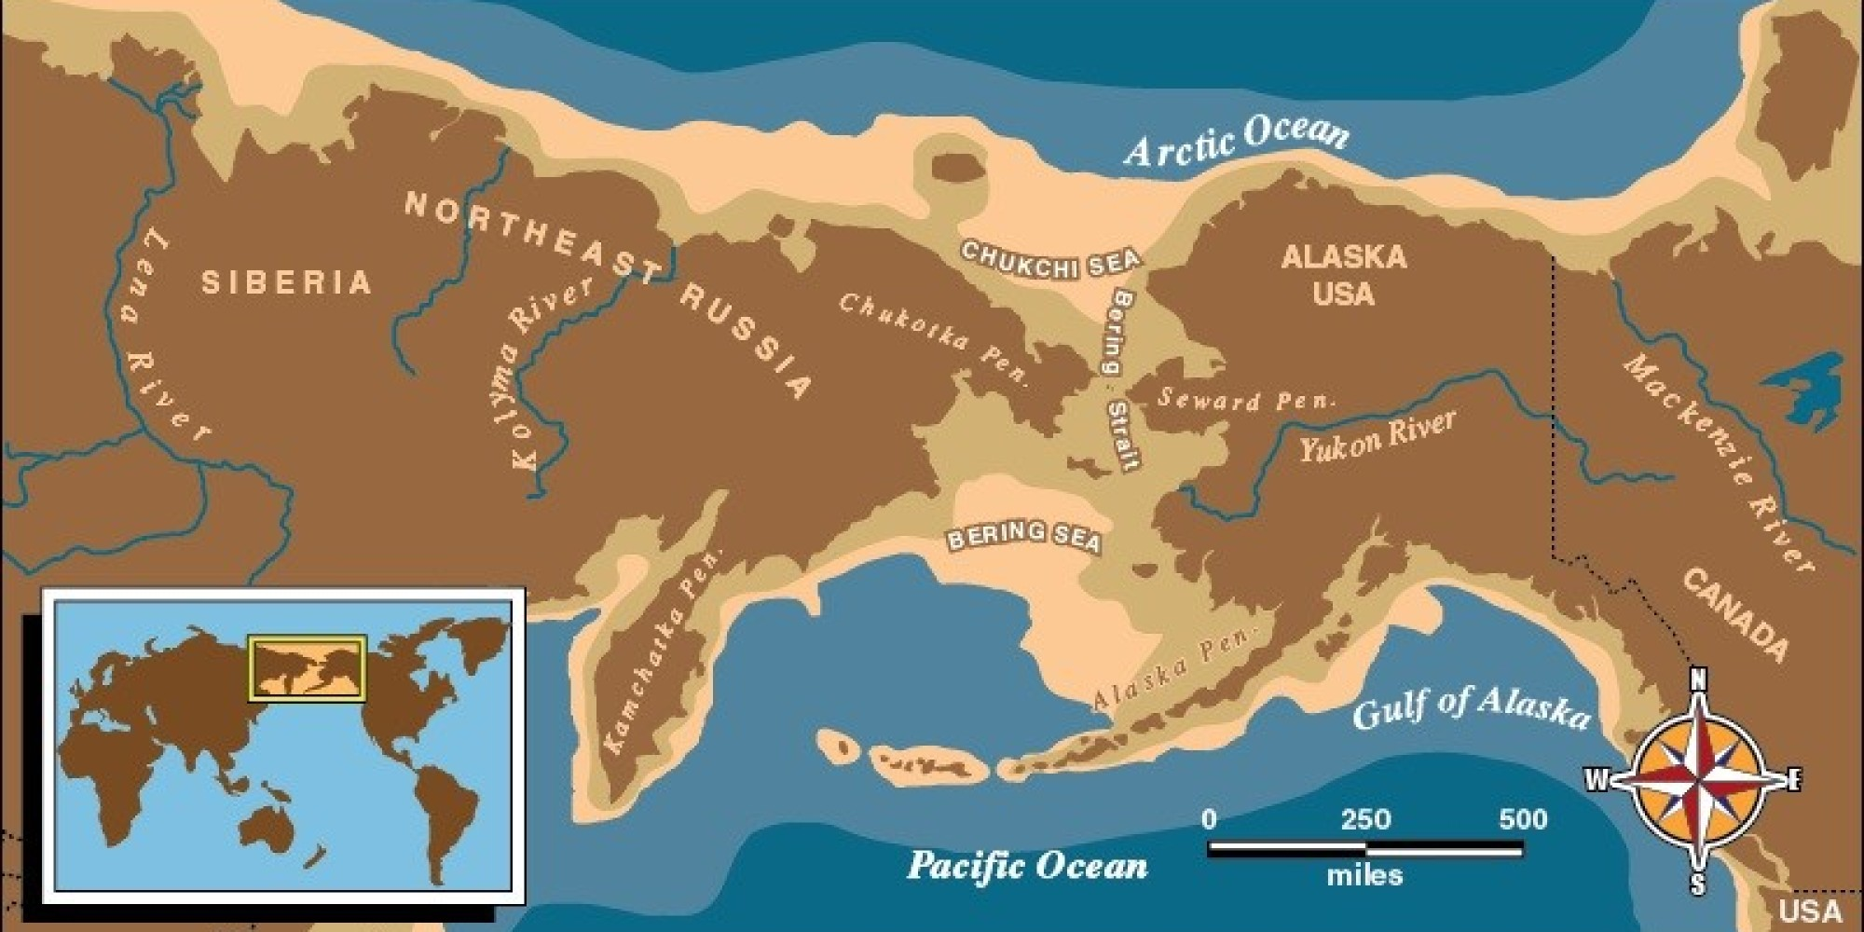
The Bering Strait
17 thousand years ago
Ice age caused sea levels to drop
Around 70 people made the journey to the America’s
Explain genetic connection between Asians and Native Americans

Slide 3
The Beringia Standstill
People moved from East Asia to Beringia
Stayed for 10,000 years
Moved over the land bridge 16,000 years ago with 5,000 people
Explains genetic mutations, no archaeological evidence

Slide 5
Bering Strait Contradictions
Contradicts Native origin stories
Stone tools at Serra da Capivara National Park (Brazil) dates humans at least 22,000 years ago
Spear points at Clovis, New Mexico placed humans in the America’s 32,000 years ago
Human campsites in Lewisville, Texas placed humans 37,000 years ago (2k more later)

Slide 6
The Politicization of Science
Alex Hewin (Native science writer) traces the Bering Strait theory to the when science was subject to Christian theology
Bible says humans could not have been here for more than a few thousand years, and could not have been in the America’s for a more than 5 thousand years
Idea that Natives were genetic descendants of Europeans was contested as it was pushed that “indigenous peoples [were] genetically inferior to white Europeans”

Slide 7
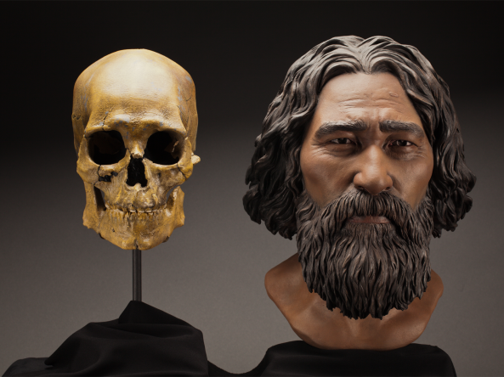
The Kennewick Man
Nearly complete skeleton found in 1996.
Found in the vicinity of extinct Native homelands
Early assessments determined that the skeleton was Native American

Slide 8
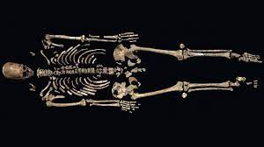
The Ancient One
A man 40-50 years old
Radiocarbon-dated to 9000 BCE
Later thought to be Polynesian or Japanese Ainu
Called by the local Indians as “the Ancient One”

Slide 9
The Ancient One
Was going to be returned to the Natives under the Native American Graves Protection and Repatriation Act
Contested that the skeleton was not Native American

Slide 10
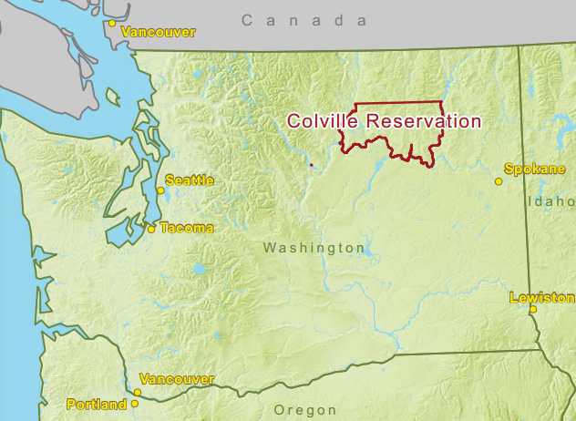
The Ancient One
2004 ruled the Kennewick Man was not Native American
2015, DNA testing concluded that the Ancient One was most strongly related to the Colville Indians, one of the Native communities in the area

Slide 11
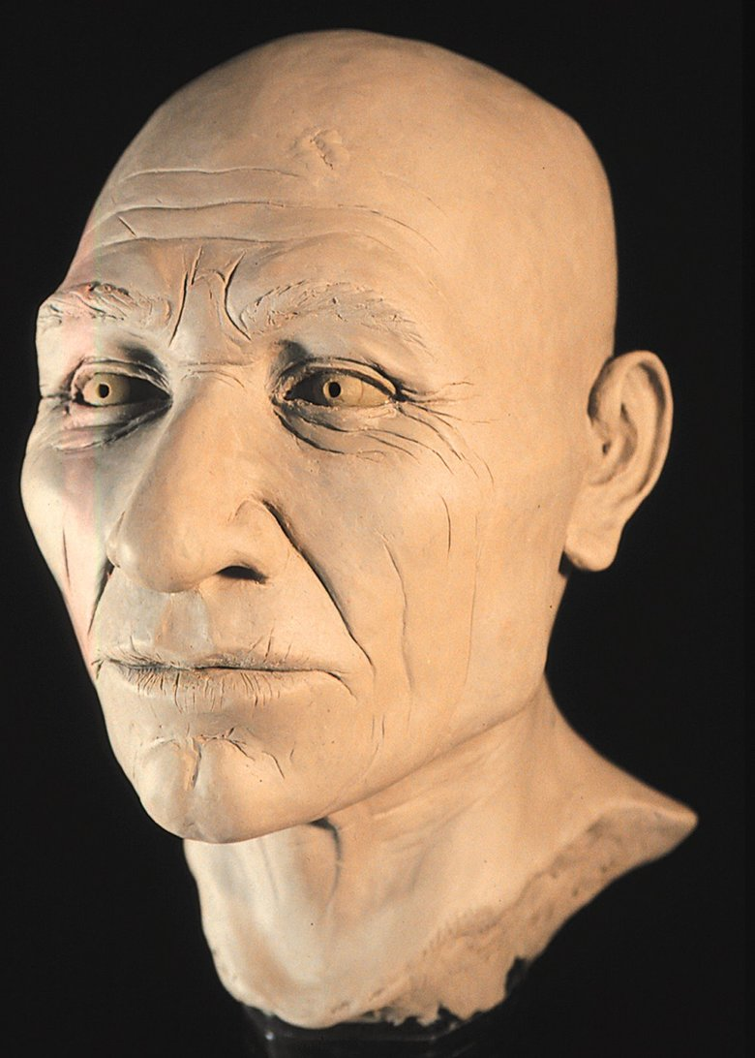
The Significance
Politicization of Science
Ignored Native beliefs and rights
Constant shifting of the narrative

Slide 12
Conclusion
Bering Strait theory does not align with the evidence that has been found
That evidence is dismissed at first despite its validity
The Bering Strait theory is constantly being changed to fit the new evidence and still be the “correct hypothesis”
Humans have been in the Americas for much longer than the Bering Strait theory could account for

