Slide 1
The Low Art of Stall-Scrawl
By: Conor Cashman

Slide 2
The Bathroom Space
The dualistic private/public space of the bathroom
Blair discusses the supplemental commemoration – the flowers, books, cards, left by visitors – as having the power to “transmute the commemorative site to a completed text for individual, but still public, memory practices” (40). Therefore, with the dialectic stall-scrawlers, who supplement each other’s writing, the space of the bathroom is perversely being transmuted into a “completed text” for all individuals in that public/private space.
The insignificance of the public restroom allows individuals to exert their power over it.
“Architecture, like natural language use, expresses degrees of significance not just through its symbolic substance but by its very existence” (Blair 34).
This is the only public space where one’s vulnerability is exposed (where one is literally caught with their pants down).
Hence – to overcompensate for our immense vulnerability and to fill the time spent in the stall, we exert power over the space by writing on its walls (Toilet Confidence).

Slide 3
The Stall Scrawler (or Bathroom Trickster)
“The trickster is many things, and is no thing as well. Ambivalent, anti-definitional, the trickster is slippery and constantly mutable […] Trickster discourse is deflative; it exposes the lies we tell ourselves and, at the same time, exposes the necessity of those lies to our daily material existence. Trickster discourse asks ‘Isn’t the world a crock of shit?,’ but also answers with ‘Well, if we didn’t have this crock of shit, what would we do for a world?’ The trickster asks us to be fully conscious to the simple inconsistencies that inhabit our reality” (Powell, 9).

Slide 4
The Art of the Toilet
The following six-minute video discusses the private space of the toilet, the differences between the Men’s room and the Women’s room graffiti, and offers explanations for why humans so readily manipulate this specific space. Specifically, we will watch the first minute and a half where explanations are offered for the purpose behind this low art form.
http://current.com/items/89203704_the-art-of-the-toilet.htm

Slide 5
Bathroom Art Forms
Bathroom High Art – These works of art took time, forethought, supplies (such as paint), and talent. Due to this type of professionalism, I chose not to analyze this area due to its level of contrivance.
Bathroom Low Art - These works were ostensibly done with no forethought, minimal supplies, and no exceptional talent; in short they appear as a result of human spontaneity.

Slide 6
Bathroom Low Art Forms
Poetry
Prose
Aphorism/One-liners
Cartoons/Drawings
Dialectical Responses

Slide 7
Bathroom Low Art Themes
Anonymity
Recognition of Mortality
Vulgarity and Violence
Politics
Humor
Philosophy

Slide 8
Anonymity and Lack of Consequence
The most defining quality of the low art of stall scrawl is the anonymity of the creator. Unlike other genres, the scrawler generally is not an artist; instead, he or she is a regular person who only creates because he or she recognizes that they are in a wholly private space, there will be no consequences, there will be no judgment. And if there are judgments or consequences or if knowledge of a creation becomes public, the creator is insulated through his or her anonymity.

Slide 9
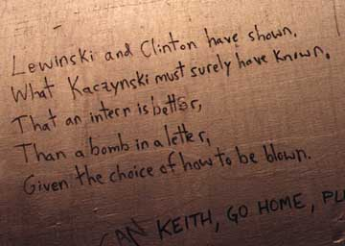
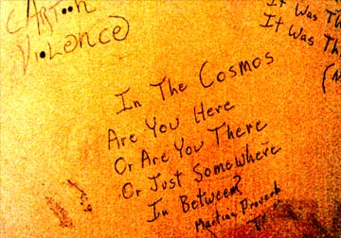
Poetry and Philosophy

Slide 10
Poetry and Philosophy Thoughts
Most philosophic comments have to do with the futility of existence; hence, I see these as reactions against the temporality of existence or their therapeutic handling of their own mortality.
The poetry typically ranges in tone, from witty humor to divulgence of private emotions.

Slide 11
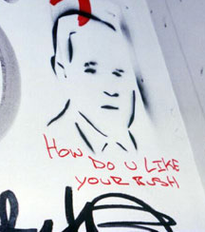
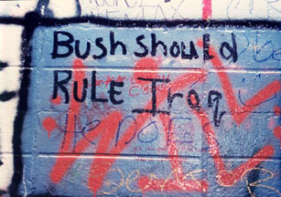
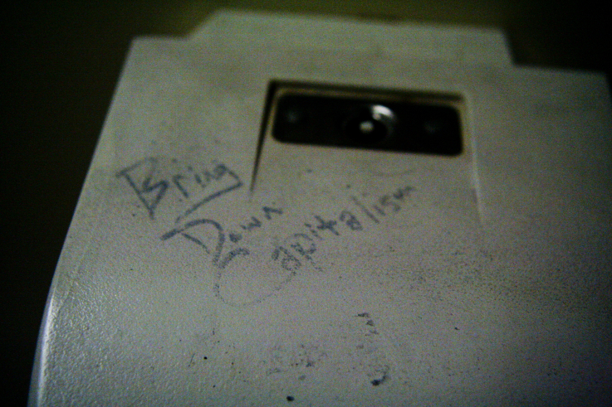
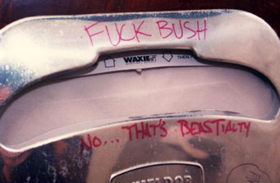
Political Commentary

Slide 12
Political Thoughts
“The socio-economic politics of transnational corporate states are impacting every facet of life on the plant, from soybeans to human beings, from manufactured wars to fabricated moments. As the psyche of humanity is being force-fed the politics of fear, emotional pandemics and global insecurity, the trauma-based control is at such a level of saturation that if one doesn’t question the method of conditioning, well they may already be conditioned beyond recognition” (Ferem, 98).
“Could bathroom graffiti be a more patriotic gesture than it is thought to be? After all what’s freedom without expression?” (Ferem, 97). Are these examples of freedom or simply cowardly defamation?

Slide 13
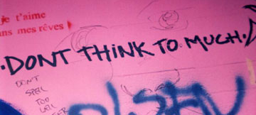
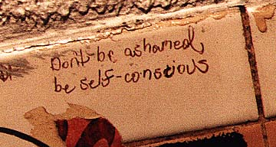
Guidance

Slide 14
Guidance Thoughts
Are these comments sincere, or are they just irreverent forms of wit?
If they are sincere, what does it say about the person who writes it? Are they unable to provide advice to the people that they are directed?
Does no one listen to their advice, so they feel the need to engrave it for anonymous readers?

Slide 15
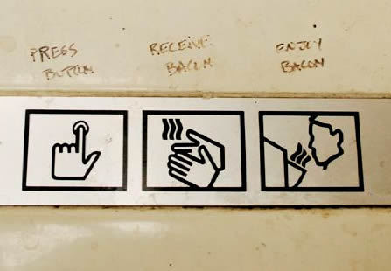
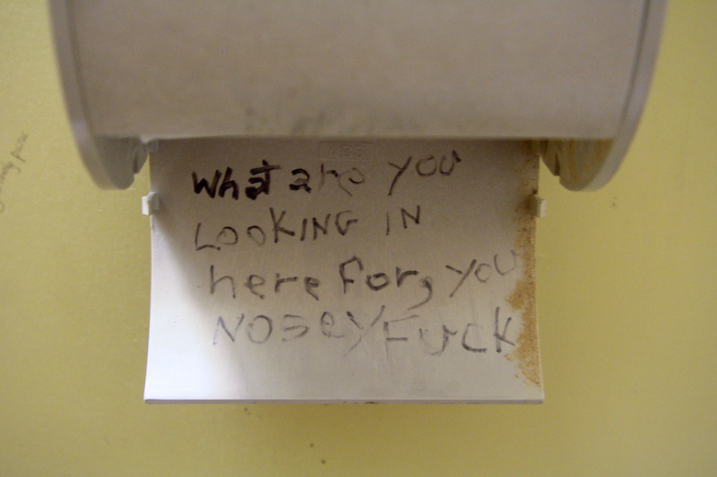
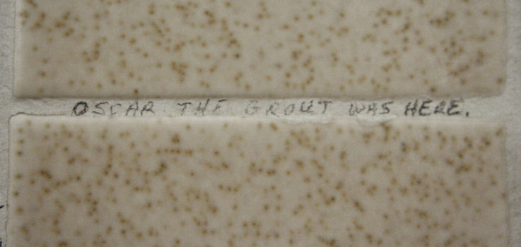
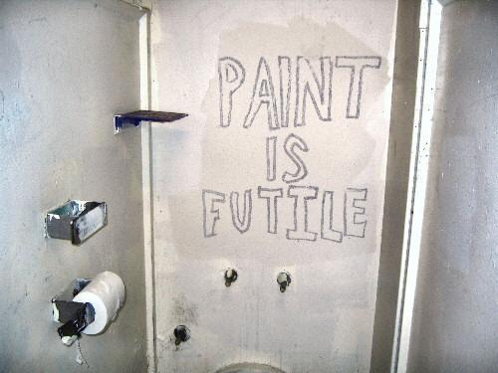
Bathroom Humor

Slide 16
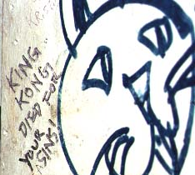
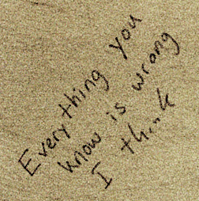
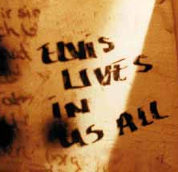
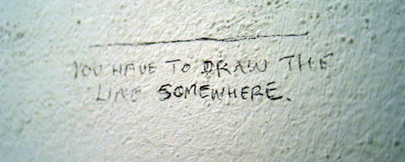
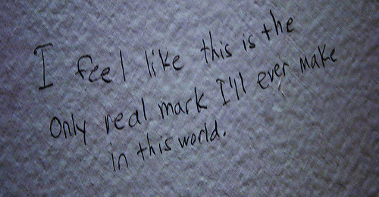
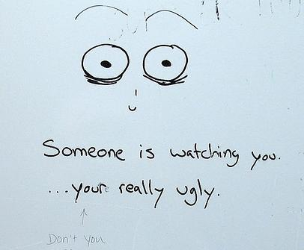
Irreverent Humor

Slide 17
Humor Thoughts
I particularly enjoy the ability of the stall-scrawler to use humor to subvert everything from the instructions on a hand-dryer to the crucifixion of Jesus to the quality of the sequel to Toy Story. These are demonstrations of wit are largely good-humored, dismissive, and are not meant to be taken seriously, but, as Ferem believes, to be taken as momentary “entertainment.”
“Acknowledging their existence maybe all that matters to the latrinalists, as theirs is the art of the people entertaining a captive audience that’s just passing through these temporary moments, dreaming of what it means to be free” (Ferem, 139)

Slide 18
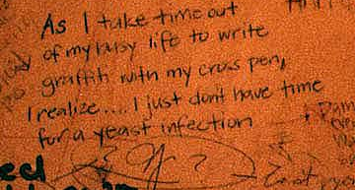
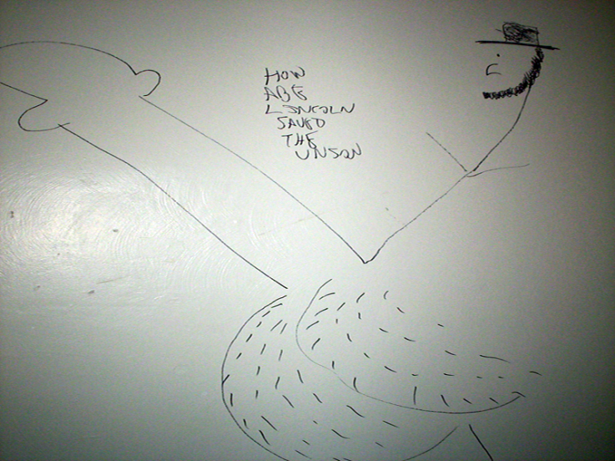
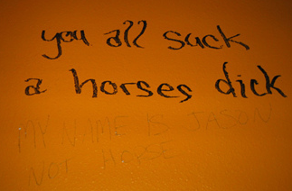
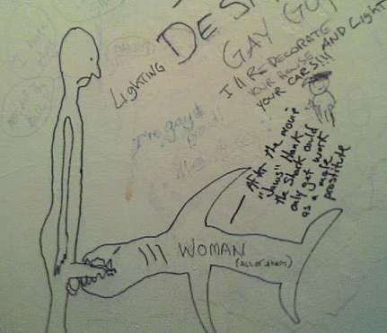
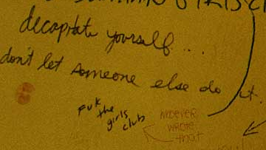
Vulgarity and Violence

Slide 19
Violence/Vulgarity Thoughts
With these pictures, we see the dark underbelly of humanity.
Some of these inappropriate pictures function solely as perverse forms of entertainment – such as the picture of Lincoln or of the shark.
Others though – such as the comments about decapitation and “the strange urges to kill” – suggest a much more psychopathic theme. They reveal someone who secretly needs to exert agency over someone else through violence. (Reminiscent of Craigs-List Killer)

Slide 20
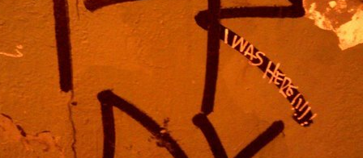
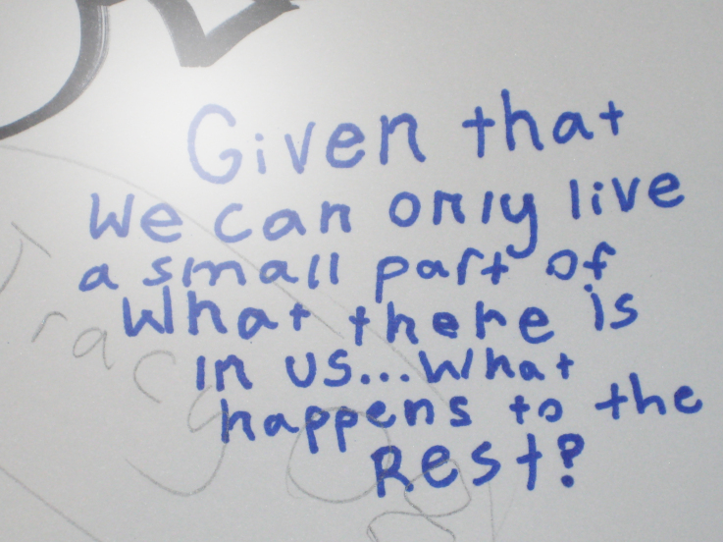
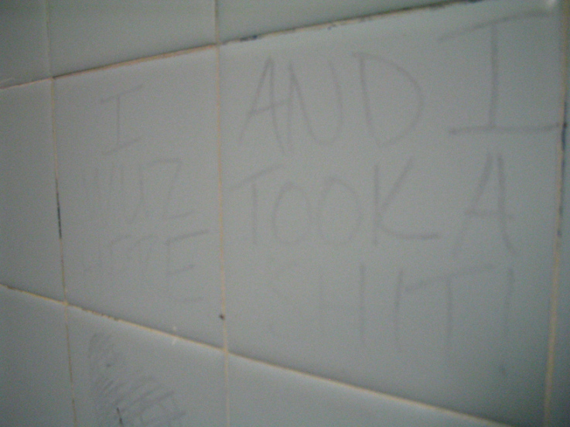
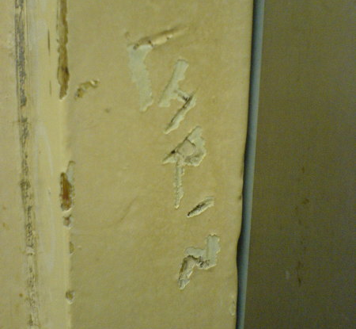
Recognition of Mortality

Slide 21
Mortality Thoughts
The writing of one’s name or the writing of “________ was here” suggests a pitiful attempt at ownership, but it also suggests an attempt at prominence, and further, at permanence. Just as we sign yearbooks, the tagging of our name is our feeble reaction against our foreknowledge that the moment is fleeting, that our lives are fleeting, that the stall-scrawler might never be in this bathroom again. These petty tags –specifically due to the past tense of the verbs – show the writer’s subconscious recognition of mortality.
“Whether the restroom graffiti is a knee-jerk reaction to our collective malaise or the process of our psyche healing, it wills itself into existence. And on some level that may be validation enough” (Ferem 17).
So why do we write our names on stalls, on benches, on monuments, on trees? Prominence? Validation? Permanence?

Slide 22
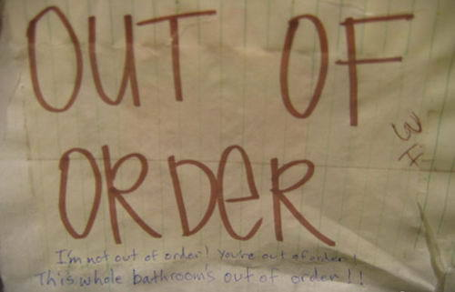
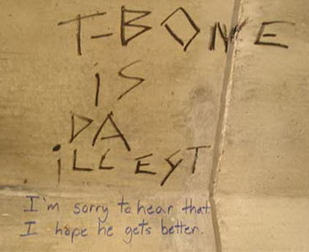
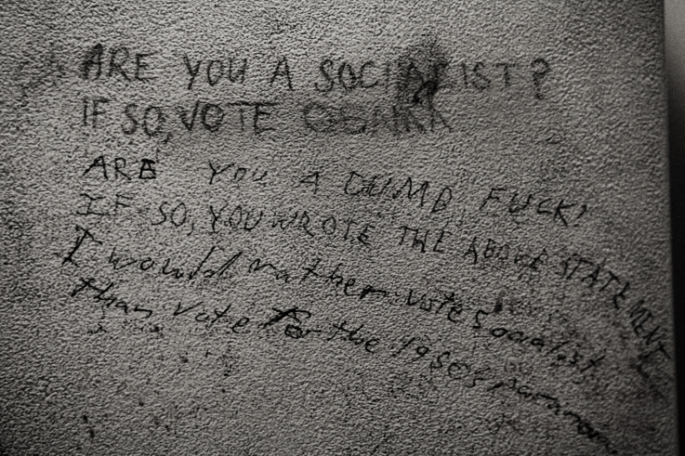
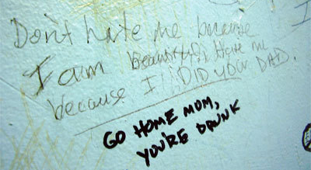
Dialectic

Slide 23
Dialectic Thoughts
The only thing more empowering than vandalizing a bathroom stall is to exert your superiority over another stall-scrawler.
Frequently, these types are mixed-mode; for instance, a poetic scrawl might be receive a comment of vulgarity or irreverent humor.
(See “Out of order” scrawl)

Slide 24
Conclusions
The low art of stall-scrawl is..
A sociological/historical artifact.
An art form separate from public graffiti.
An act of empowerment.
A desperate attempt at permanence (Defecation often exposes the temporality of the self as waste; hence, scrawling something functions as a reaction against this recognition of insignificance).
A psychological outlet/canvas for Man’s private emotions (The subconscious Id) that typically are not accepted in a public space (Thoughts such as jealousy, perversion, desire, human insignificance).
A satirical comedy of manners (See all humor sections)
An exercise in meaningful insignificance (Lack of consequences) – see examples of political commentary, religious criticism, advice, dialectical responses.

Slide 25
Pictures Cited
n.d. 30 July. 2009 <http://www.graffitiproject.com/>.
n.d. 3 August . 2009 <http://www.itsallinthehead.com/>.

