Slide 1
“We are still here”: Indigenous Perspectives in the Classroom
Indigenous Educational Workshops
Joyce Rain Anderson, Ph.D.
Bridgewater State University

Slide 2
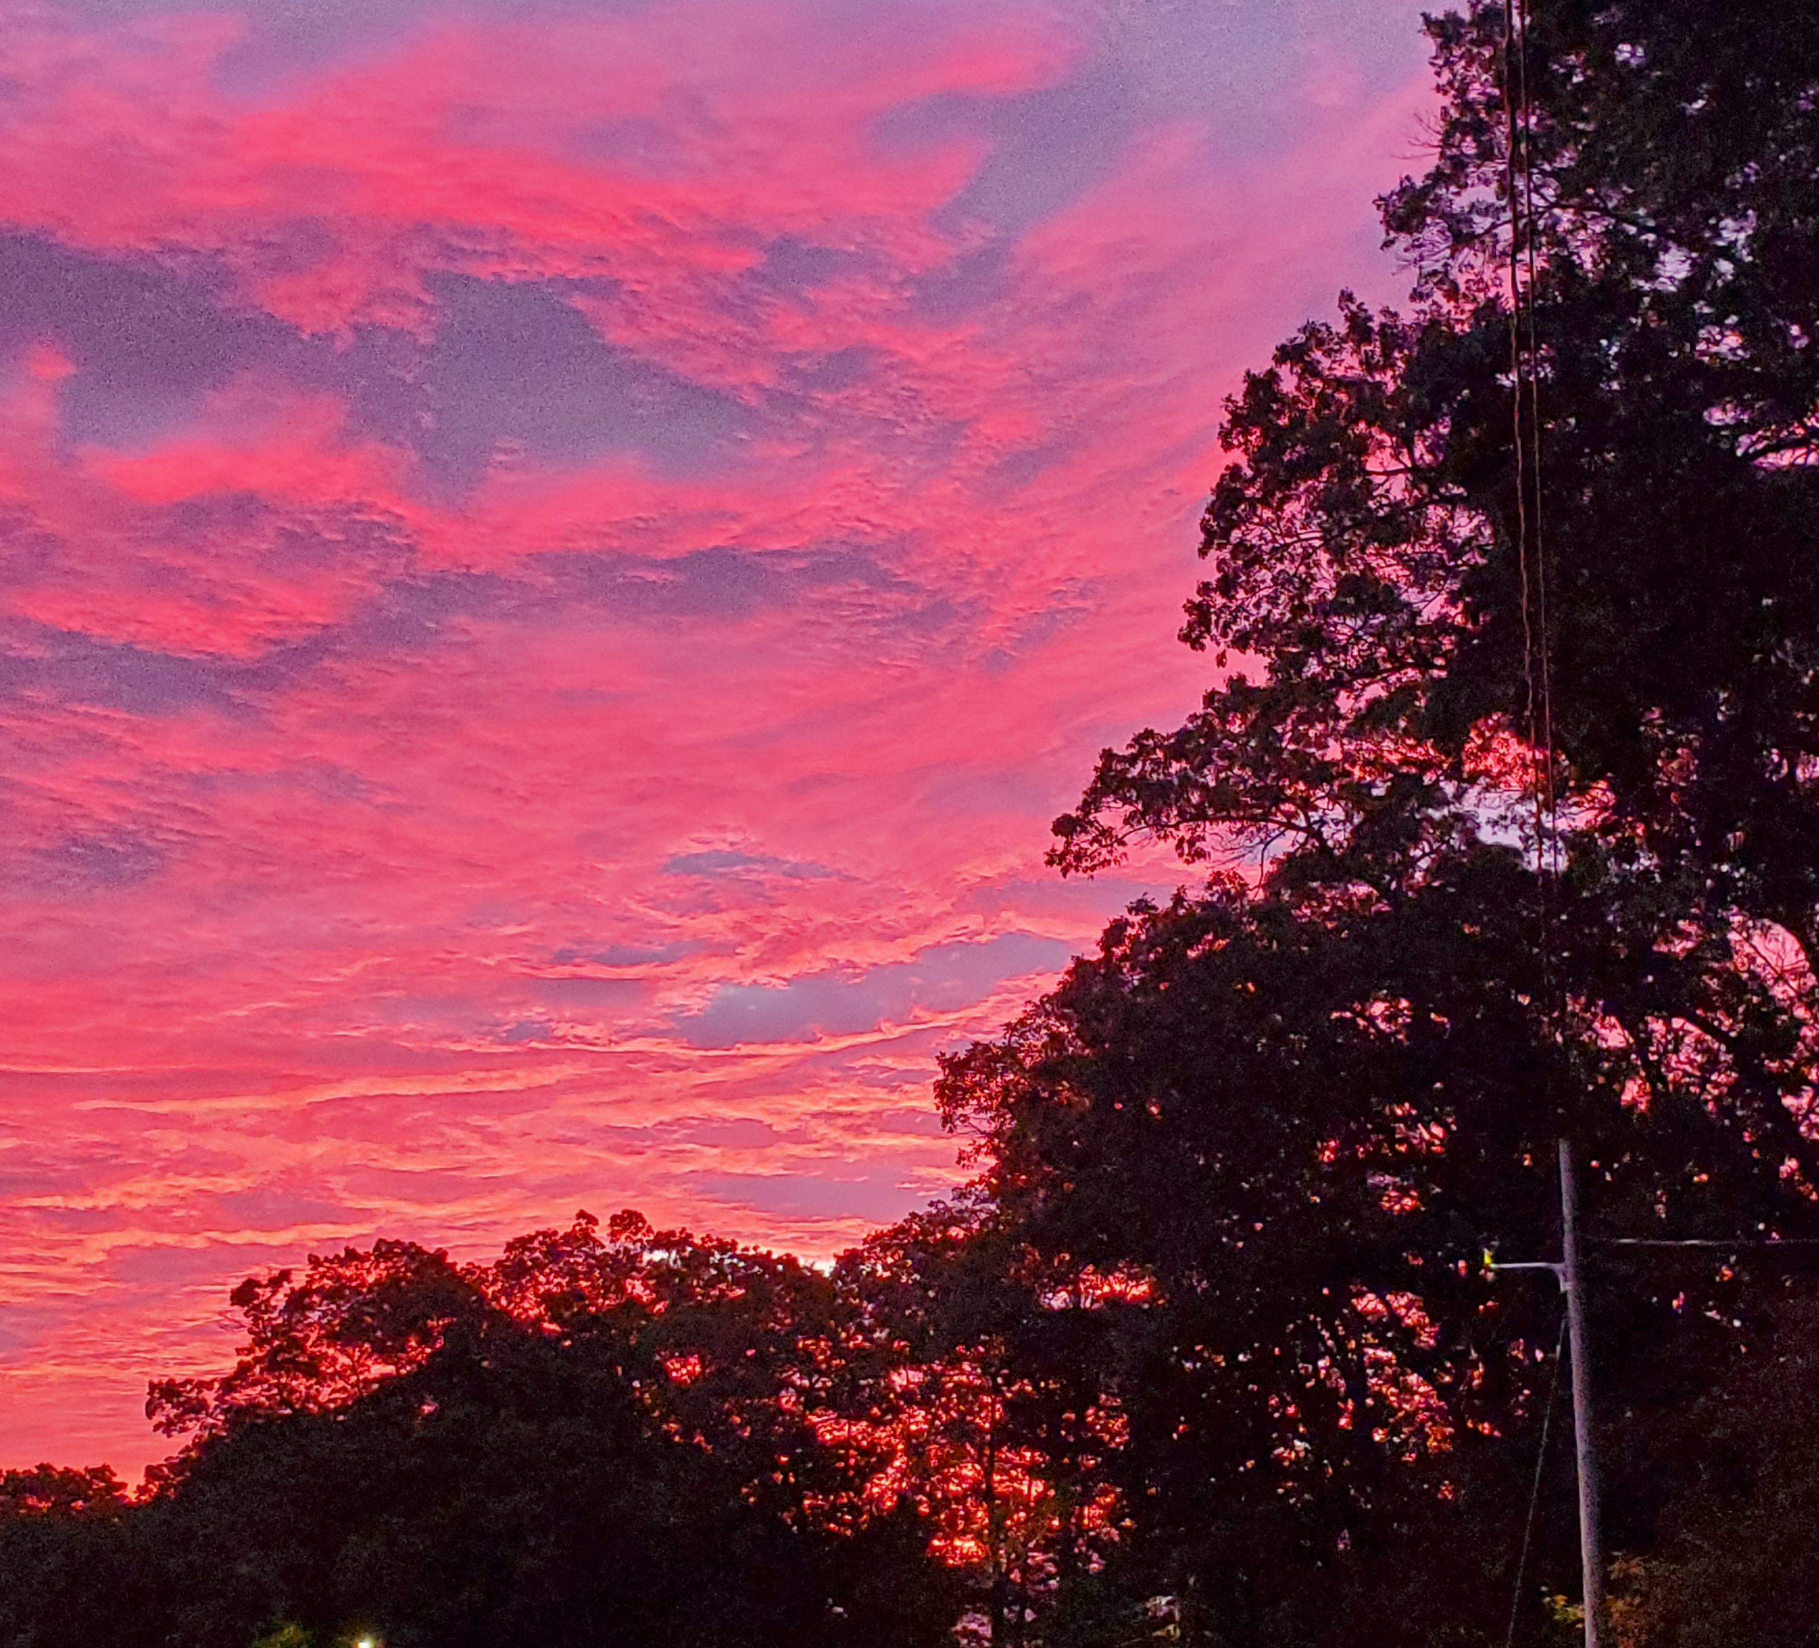
Wunnee keesuq

Slide 3
we all know what indians look and act like

Slide 4
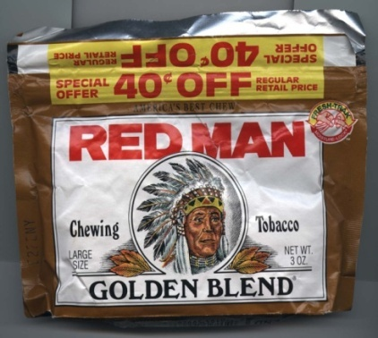
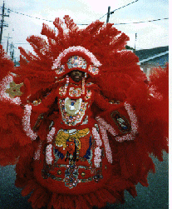
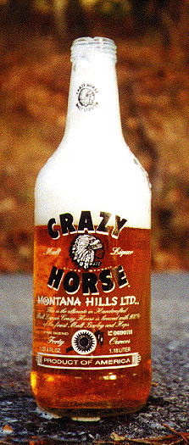
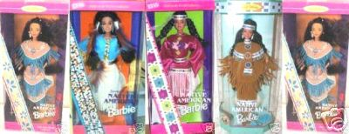
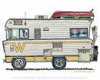
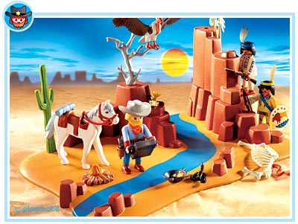
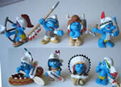
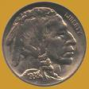
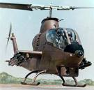
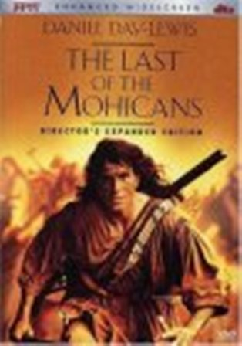
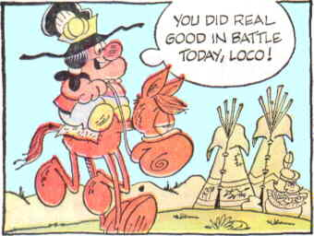
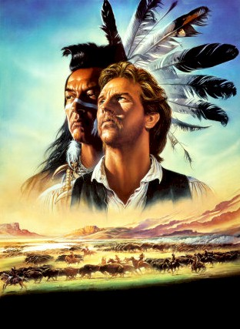
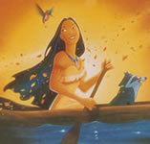
Notes:
We smoke with them, eat and drink with them. We see them in the movies, at sports events, in cartoons. Our children play with them. We see them on the roadways or in the air(especially during wartime).

Slide 5
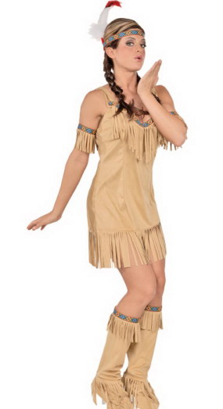
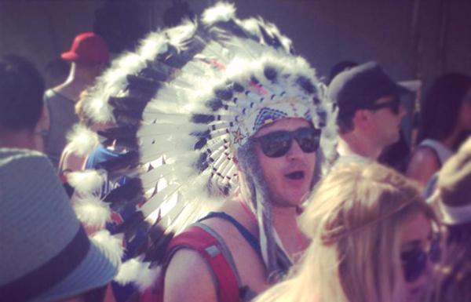
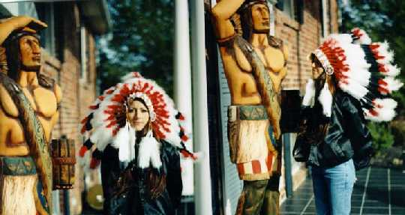
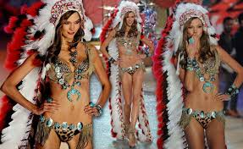
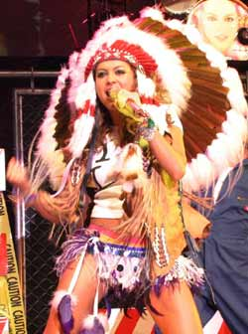
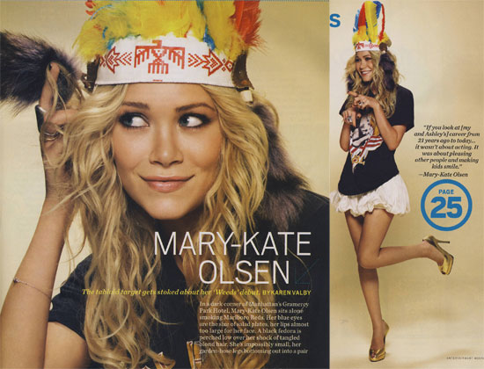
Notes:
What’s more, we see everybody dressing like them from dolls, to fashion shows, to music festivals….sigh. So we know what the Indian looks like.

Slide 6
1575 Vespucci’s image of the “new world”

Slide 7
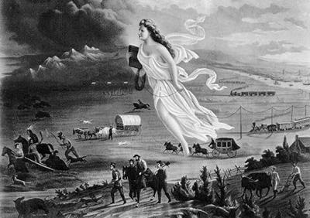
1872 John Gast’s “American Progress”=Manifest Destiny

Slide 8
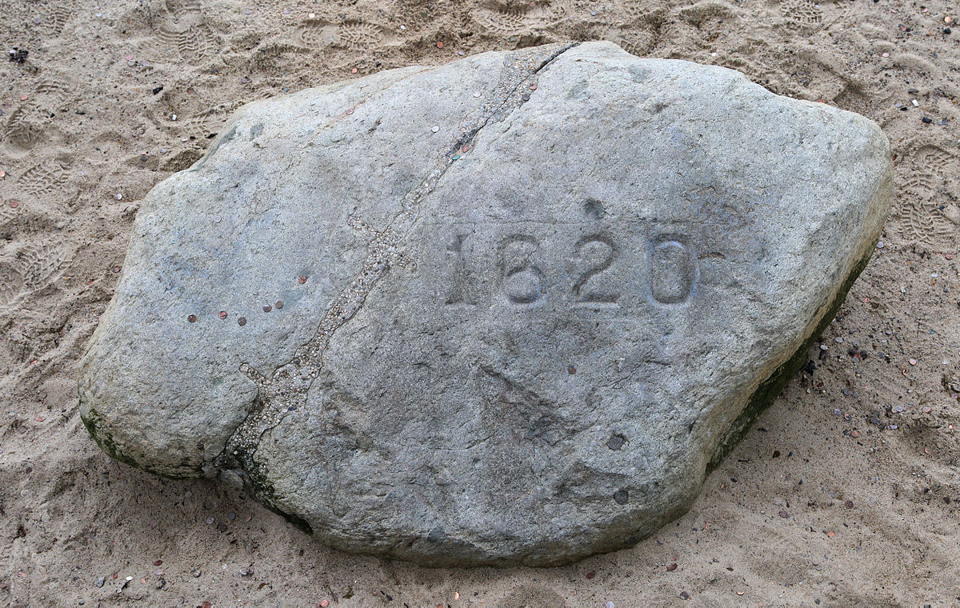
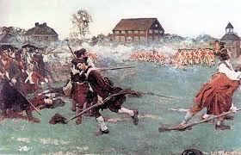
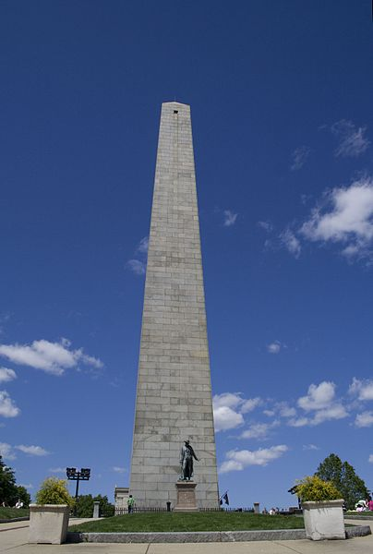
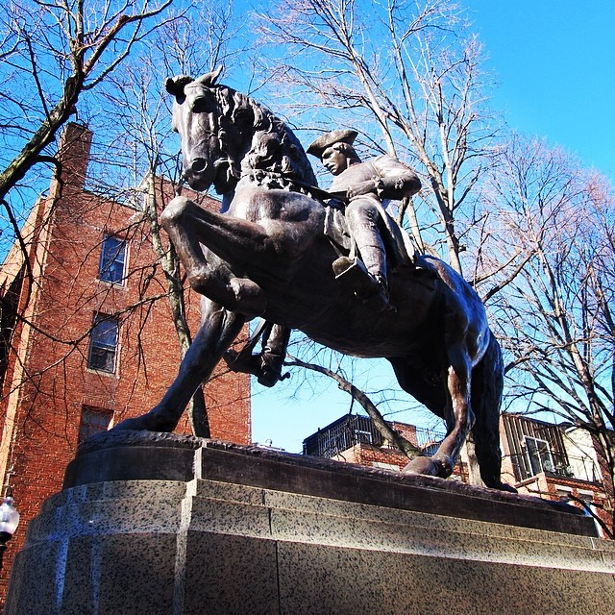

Slide 9
(Massasoit’s)1621 Peace Treaty (March 22/April 1, 1621 & September 13, 1621
TERMS OF THE TREATY
Following the introductory ceremonies, Carver and Massasoit
Ousamequin agreed upon the terms of a peace treaty between the Pilgrims and the Pokanokets. The treaty of mutual support they negotiated said in part:
1. That he nor any of his should do hurt to any of their people.
2. That if any of his did hurt any of theirs, he should send the offender, that they might punish him.
3. That if anything were taken away from any of theirs, he should cause it to be restored; and they should do the like to his.
4. If any did unjustly war against him, they would aid him; if any did war against them, he should aid them.
5. He should send to his neighbors confederates to certify them of this, that they might not wrong them, but might be likewise compromised in the conditions of peace.
6. That when their men came to them, they should leave their bows and arrows behind them.
7. That King James would esteem Massasoit (Ousamequin) as his friend and ally.
Notes:
According to the period sources, the colonists (William Bradford) recorded this as the treaty signed between Massasoit and the Plimoth colonists. However, more recent scholarship has indicated that the treaty is biased in favor of the colonists, and the likelihood of agreement to this particular version is questionable.

Slide 10
Mass Bay And Massachusetts seals
The Puritans came with an agenda to save the savages who inhabited New England. They based this notion on the Biblical mission of Paul:
A vision appeared to Paul in the night: a man of Macedonia was standing and appealing to him, and saying, "Come over to Macedonia and help us
Acts16:9
Problematic State Seal
Notes:
The Mass Bay Colony Seal has words coming from the mouth of the Native man: “Come over and help us.” These are a direct reference to the Bible, in Acts, where Paul dreams of the Macedonian saying those same words, and they meant come Christianize us.
The current Massachusetts seal has the arm and sword of Myles Standish over the Native man. In the last few decades, Native people’s have tried to have the seal changed.

Slide 11
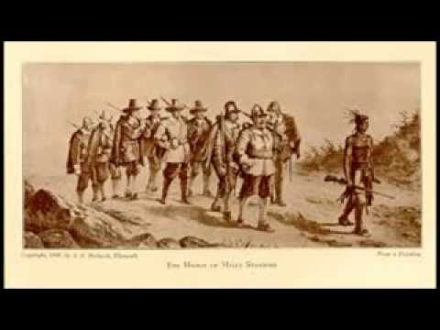
Myles Standish and Men Marching to Wessagussett to Murder Natives There

Slide 12
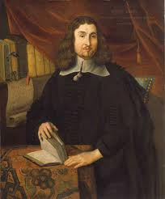
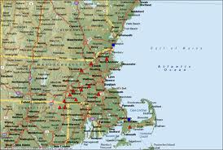
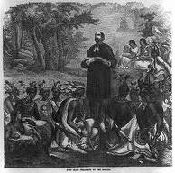
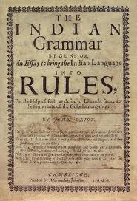
John Eliot’s Mission to the Indians
Notes:
John Eliot was a missionary who arrived in New England in 1631 and was a teacher in Roxbury. He began to learn Massachusett Alqonquin in 1643, and began his ministry to the Indians in 1946 (He made an earlier attempt, but his language skills were laughed at, so he went back to his studies.) Other misionary efforts were taking place on Aquinnah by the Mayhews. The mission of the Mass Bay Colony was to convert the Indians, and Eliot began the earliest reservaion system called Praying Towns. Natick was the first established in 1651 and by 1670, fourteen were established. After King Philip’s War (1675-76) only four were re-established.

Slide 13
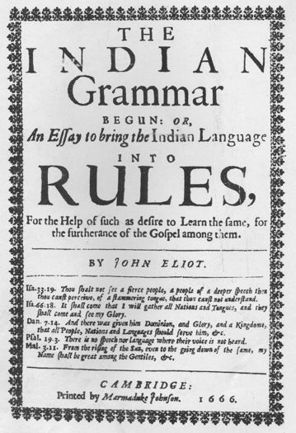
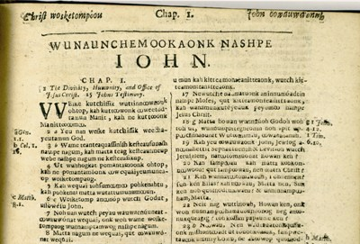

Slide 15
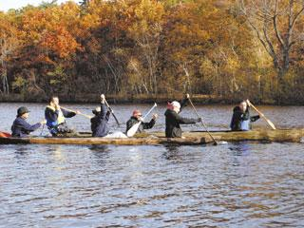

Slide 16
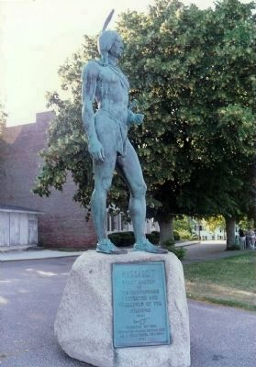
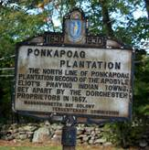
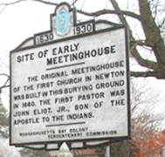
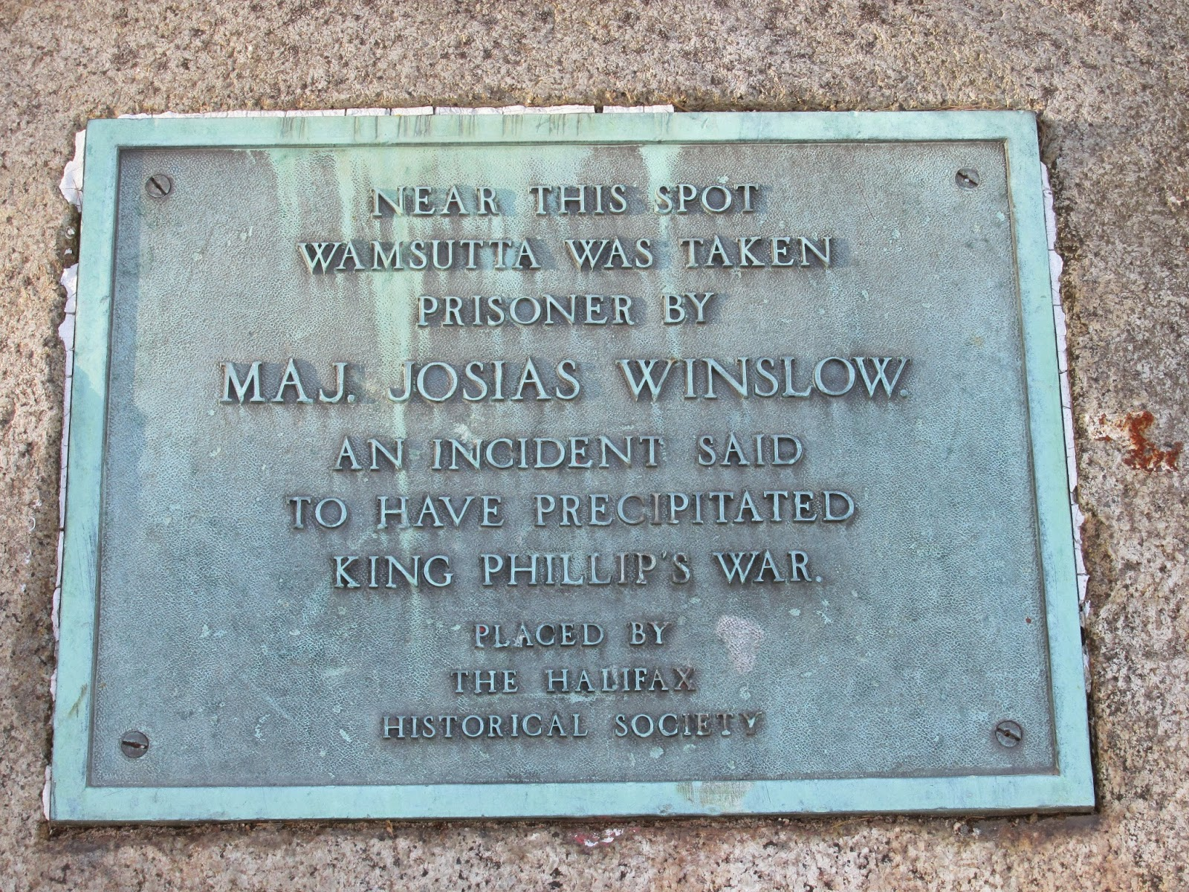
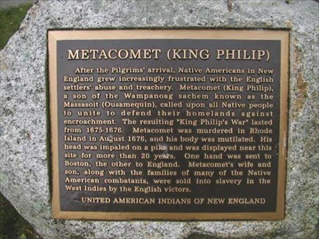

Slide 17
Metacom/King Philip

Slide 19
Like every other city or town in Massachusetts and other parts of the US, these signs represent settler colonialism. That means colonists who came to push out the original peoples and stay on their lands. Settler colonial history starts on the incorporated dates.

Slide 20
I WANT MY STUDENTS TO SITUATE THEMSELVES IN NATIVE SPACE EARLY IN THE SEMESTER. BY DOING SO THEY CAN COME TO BETTER UNDERSTAND RELATIONSHIPS TO LAND. OFTEN, MY STUDENTS WILL SAY “NATIVES LIVED IN HARMONY WITH THE LAND,” AND LEAVE IT AT THAT. BUT THAT IS A SENTIMENTAL IDEA AND DOESN’T BEGIN TO UNDERSTAND THE RELATIONSHIPS. THE MAPPING PROJECT ASKS THEM TO FIRST MAKE THEIR OWN CONNECTIONS TO HOMETOWN OR OTHER SPACE THEY CONSIDER SPECIAL OR IMPORTANT TO THEM. THEN THEY ARE ASKED TO LOOK FOR EVIDENCE OF CONTINUOUS NATIVE PRESENCE, TO INVESTIGATE THE MARKERS, NAMING OF AREAS (RIVERS, STREETS, PARKS, BUILDINGS, ETC.) AND WHAT TRIBES ARE NEAR THEM. THEN THEY DO SOME RESEARCH ON THEM.

Slide 21
https://intercontinentalcry.org/indigenous-erasure-plain-sight-place-names-new-england/

Slide 22
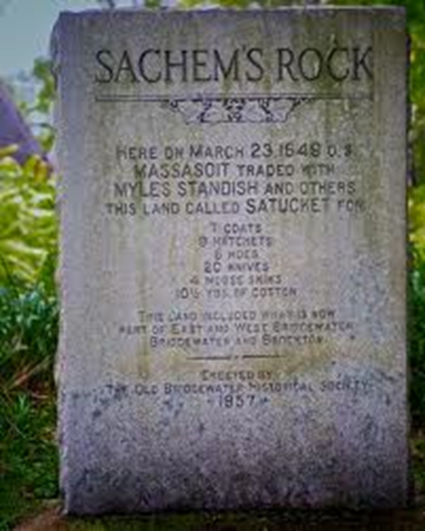
Satucket Purchase 1649 (7 miles in every way)

Slide 23
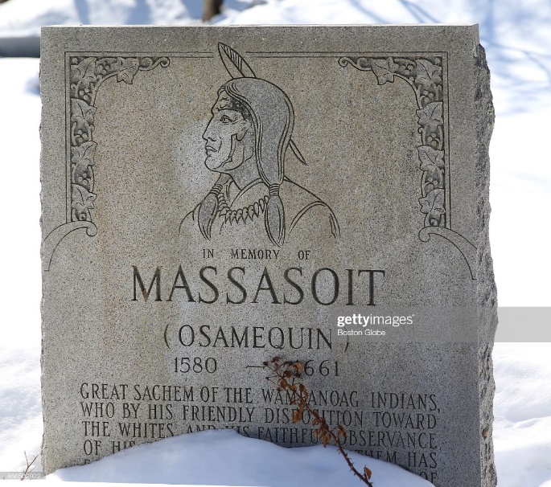
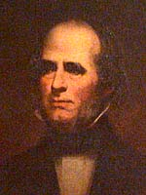
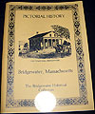
Massaquatuckquett > Saughquatuckquett > Satucket

Slide 24
So what do you know about Native history and spaces in Hingham?

Slide 25
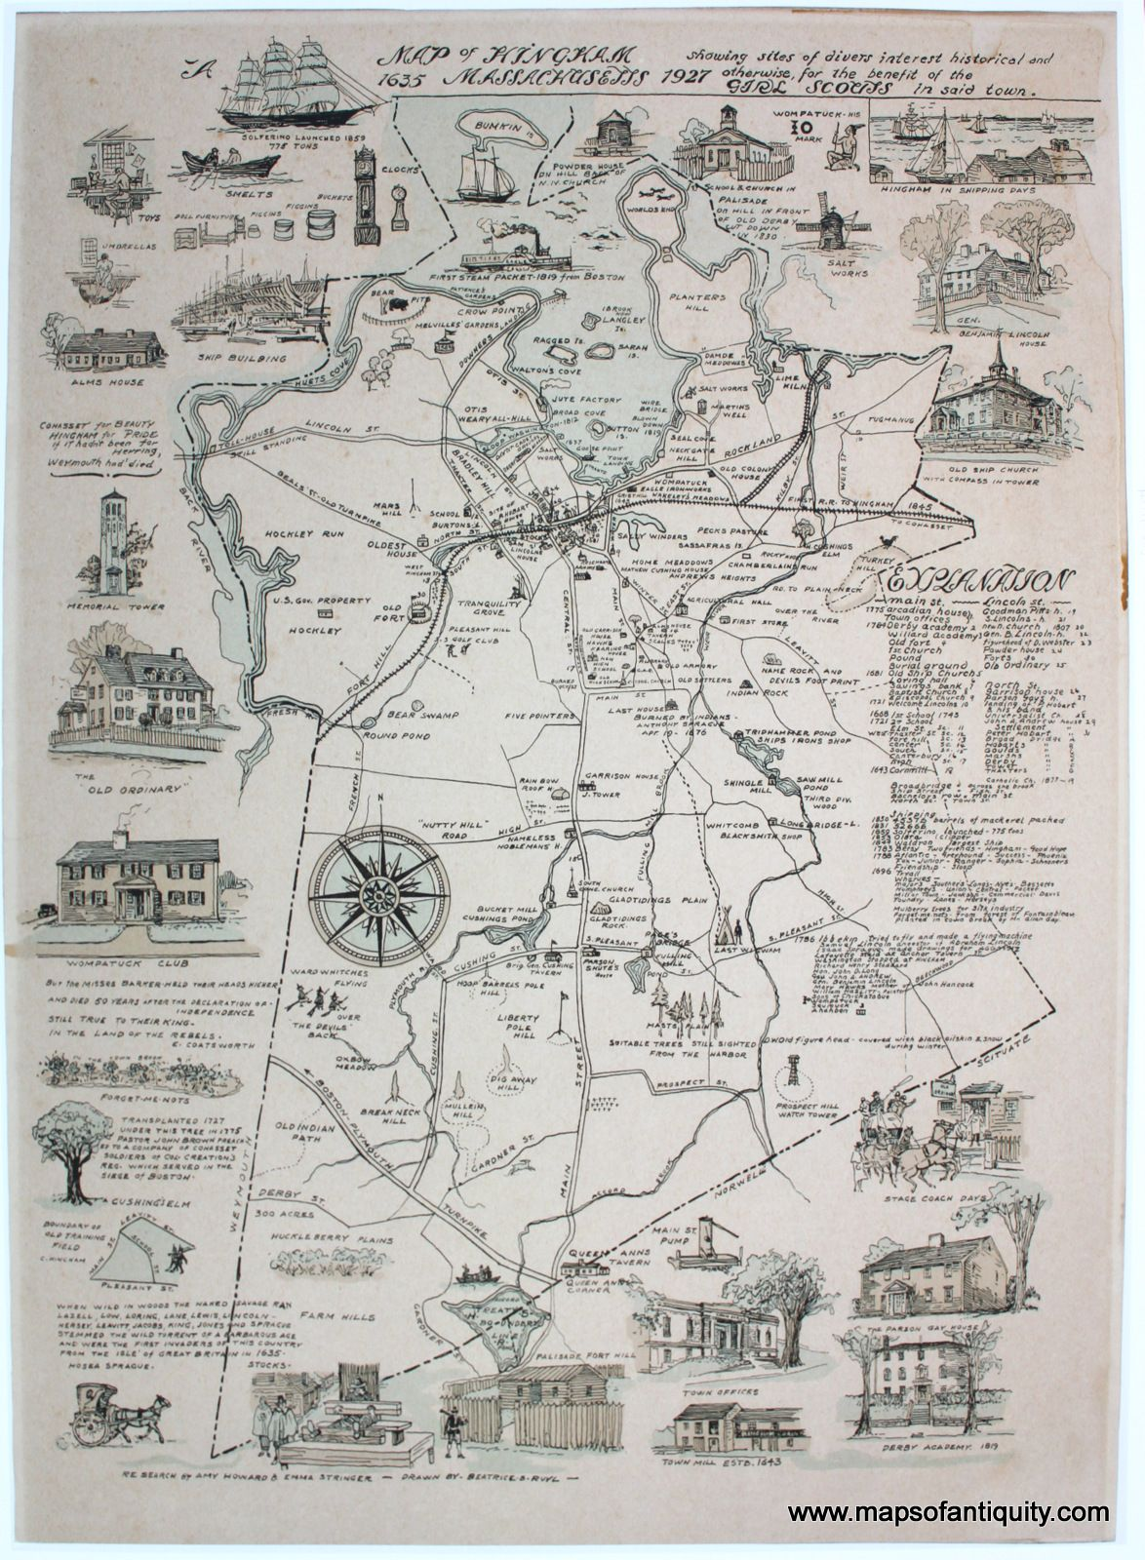

Slide 26
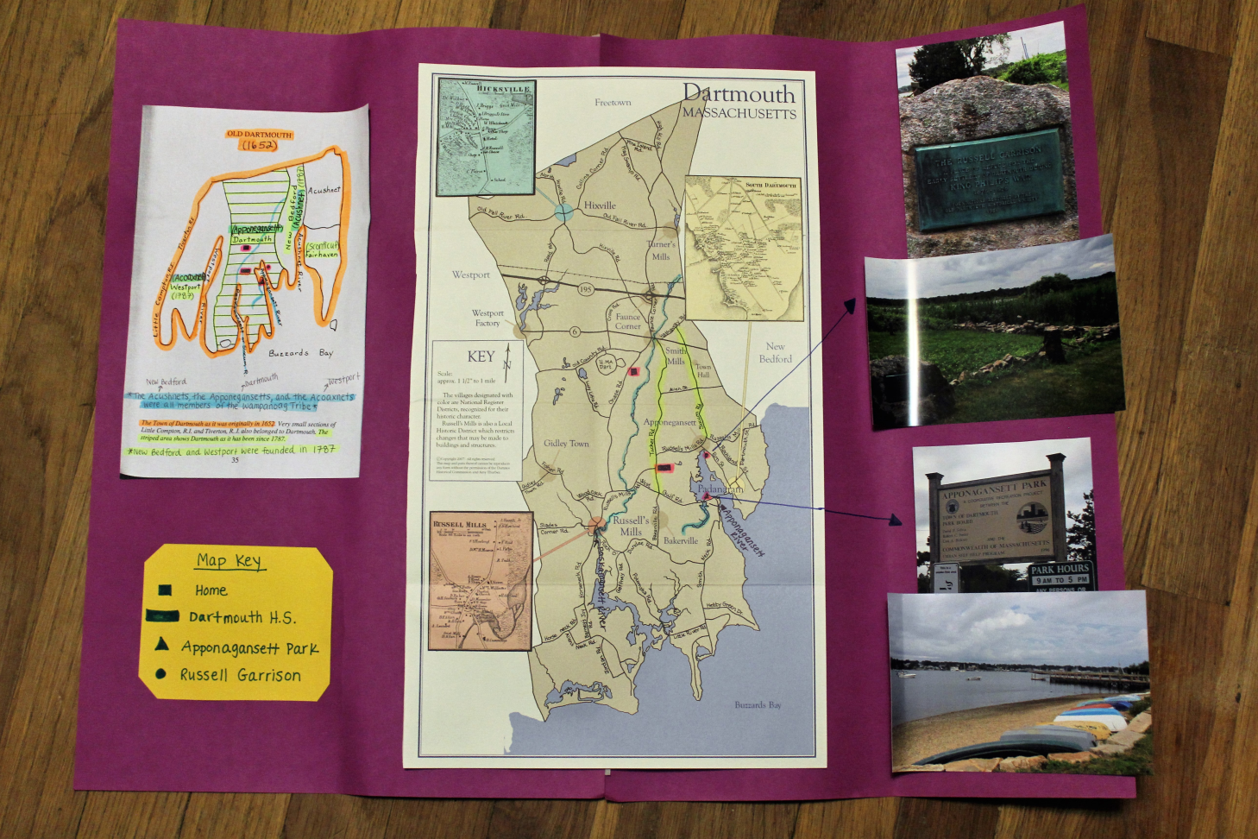
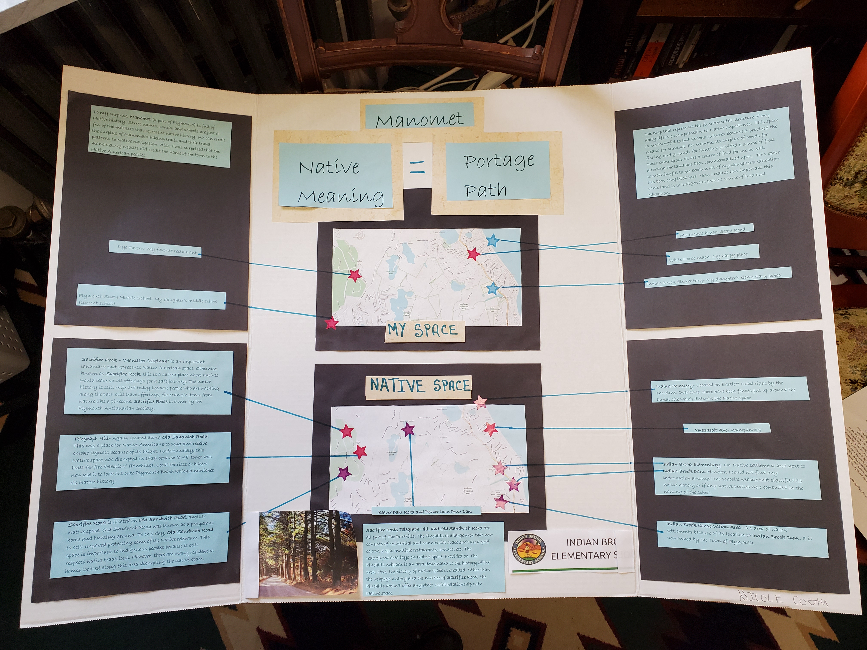
Rhetorical Mapping

Slide 27
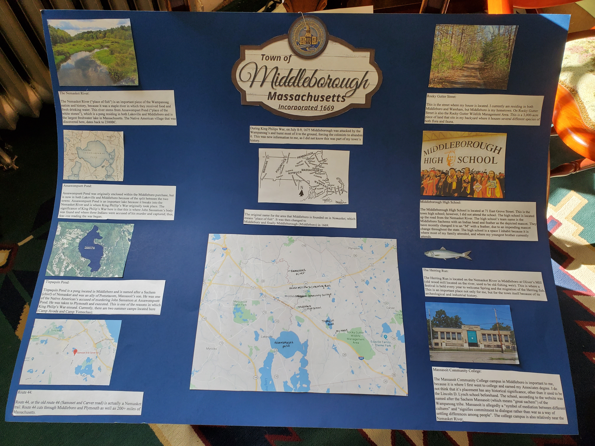

Slide 28
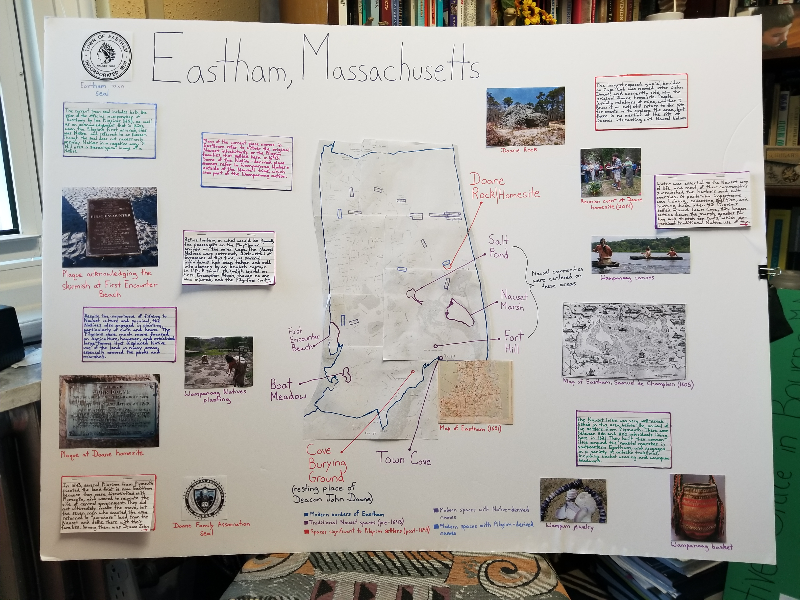
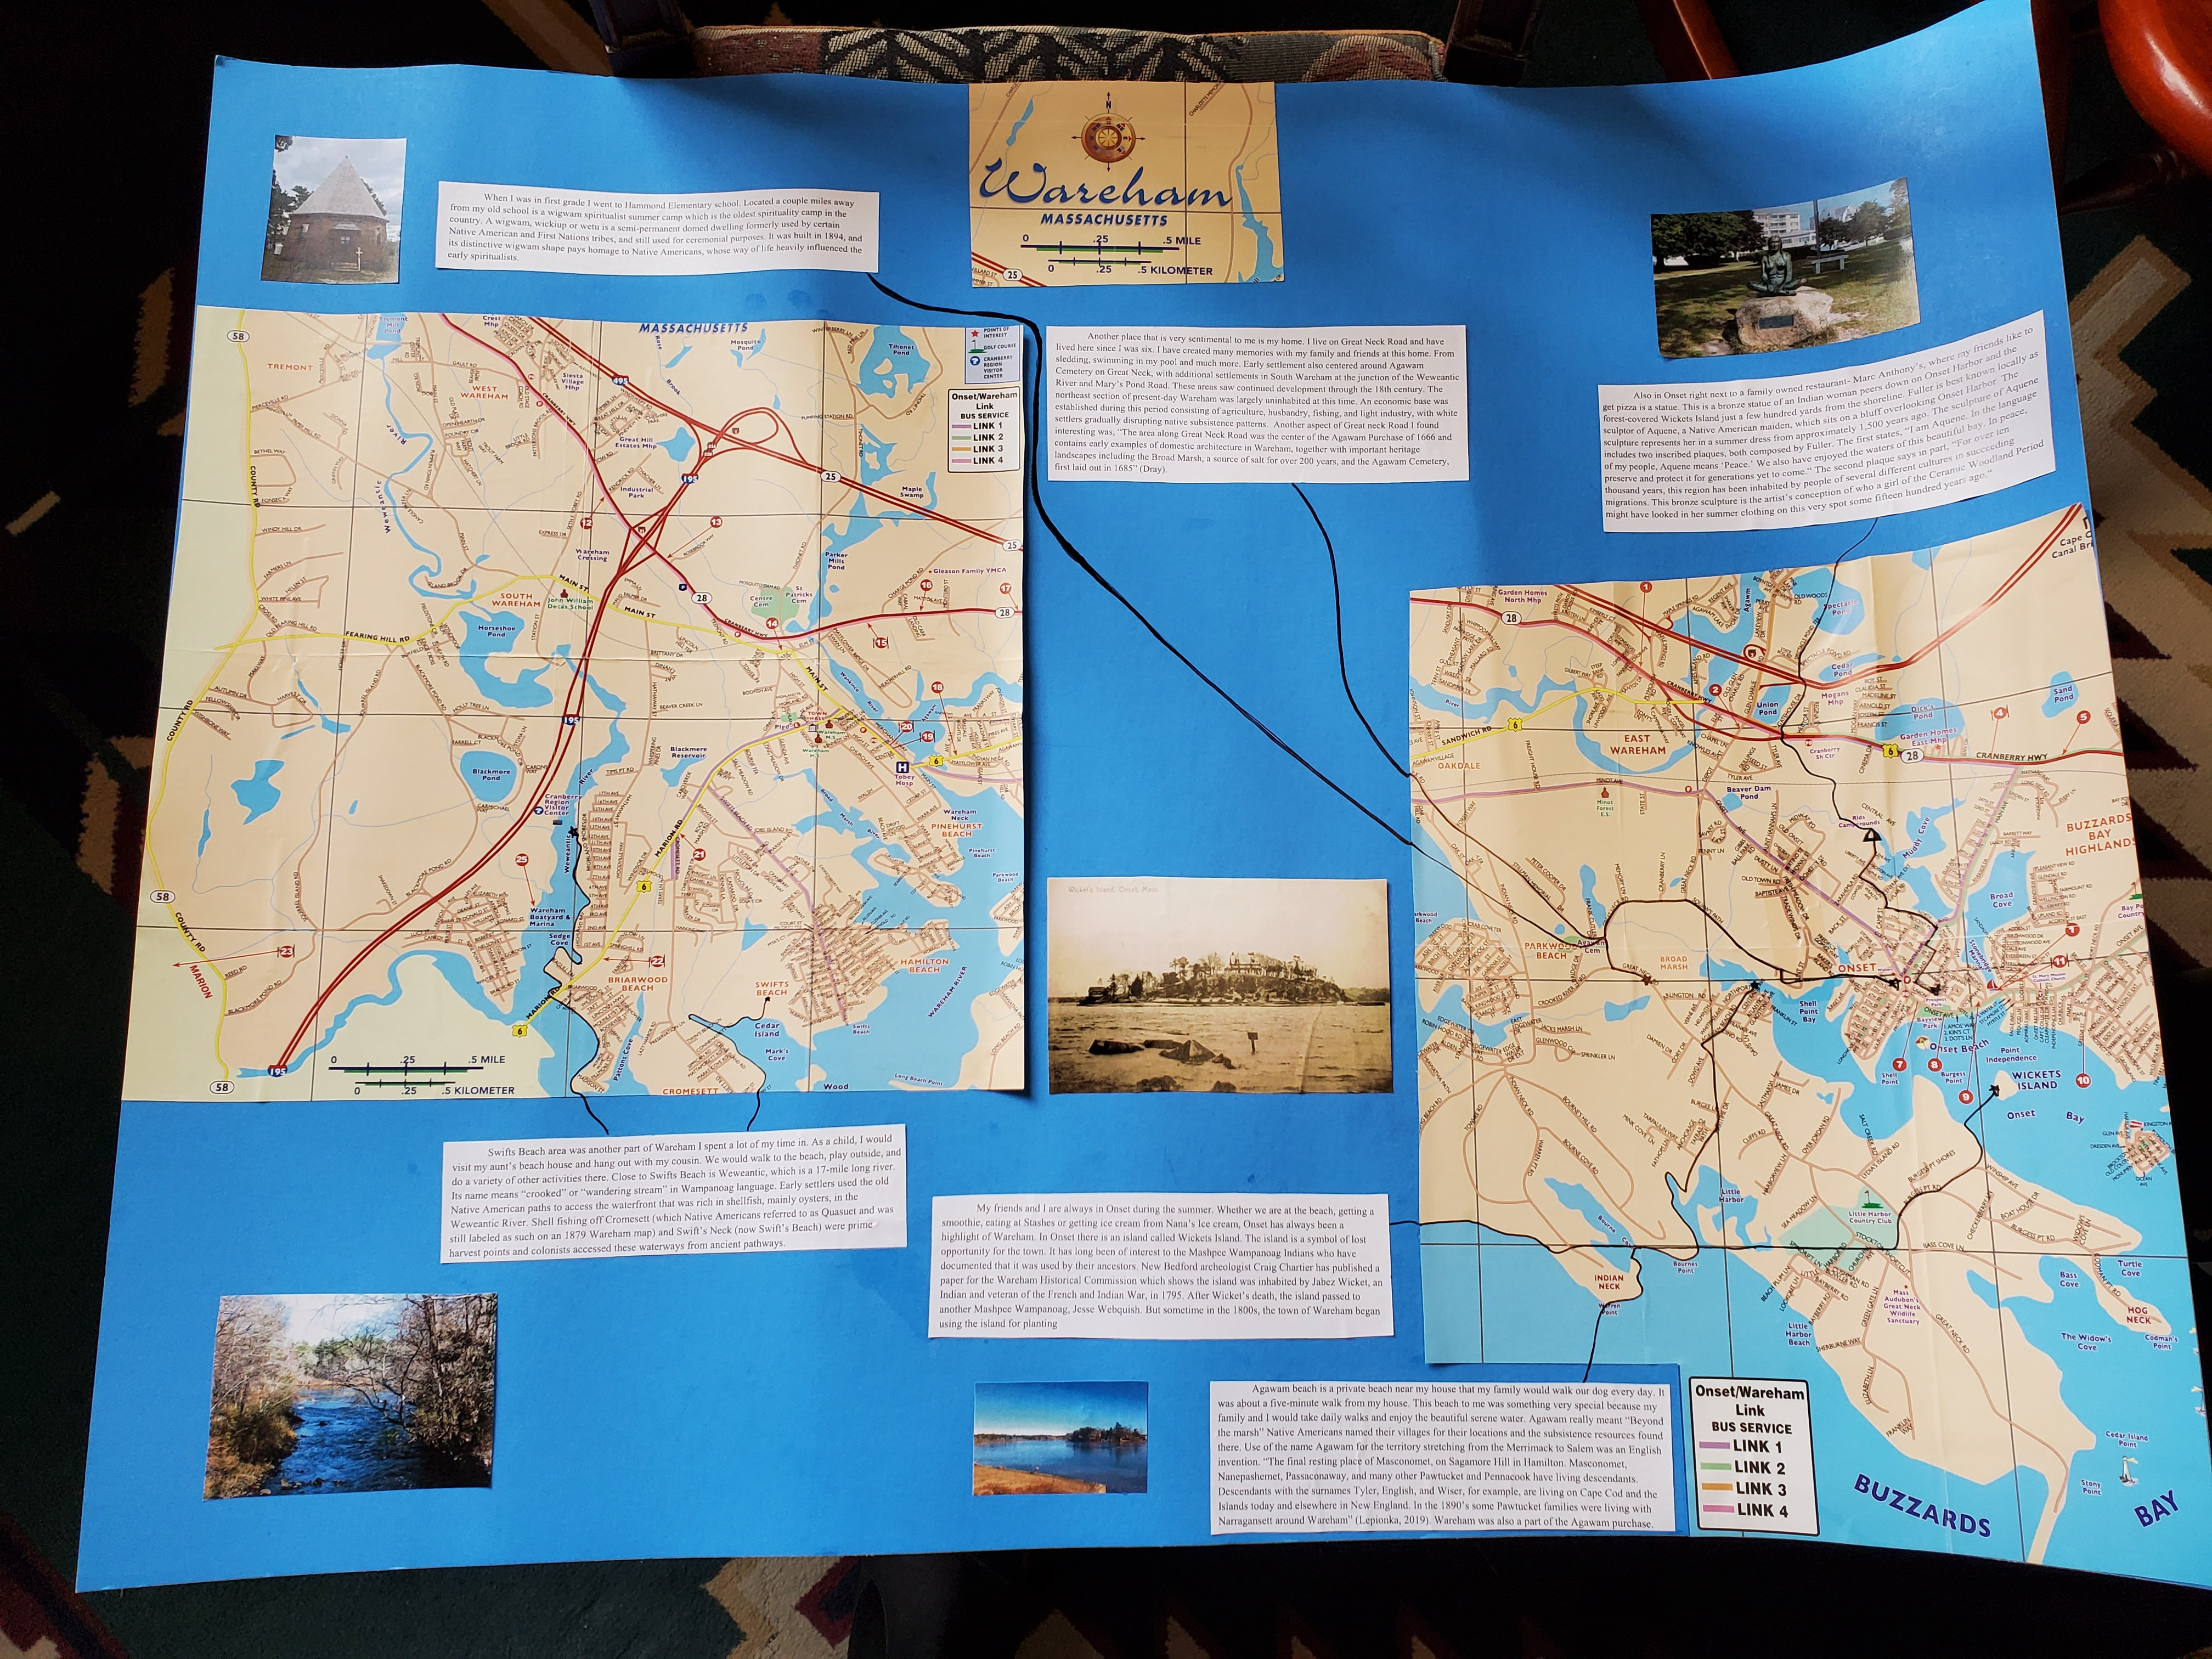
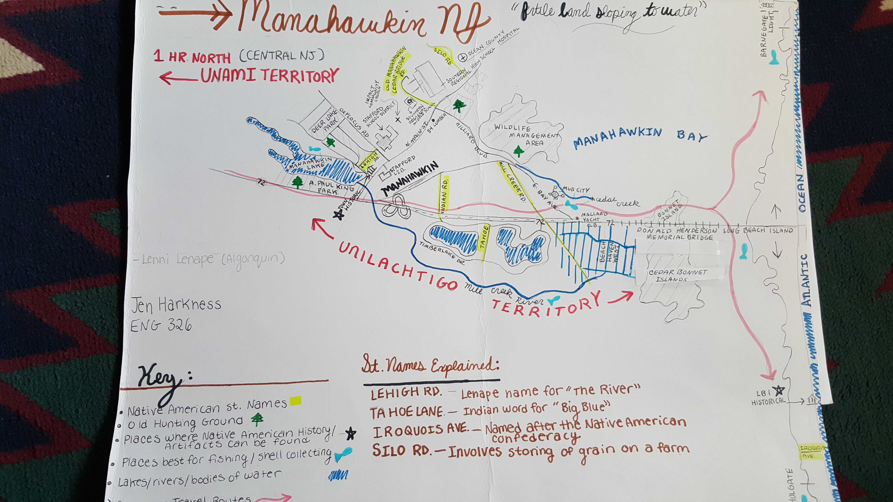
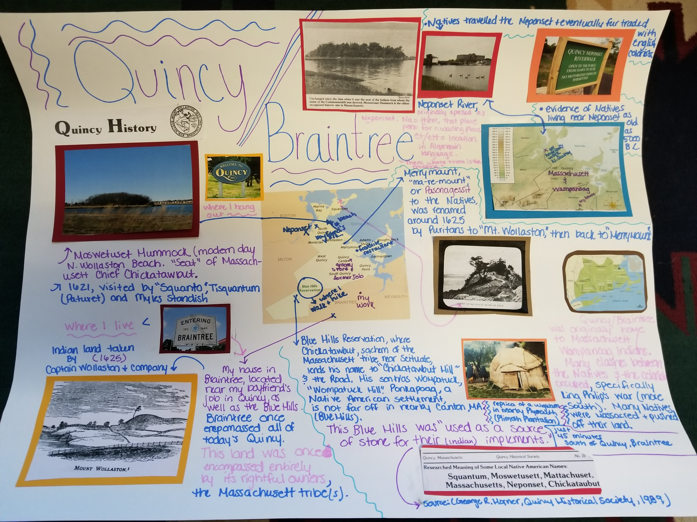

Slide 29
Origins of Corn

Slide 31
Grinding Corn at the Wampanoag Homesite Plimoth Plantation

Slide 37
Problematic Holidays

Slide 38
How would you feel if someone walked into your home and claimed everything for themselves?

Slide 39
Discovery
What does it mean to find something?
What does it mean to discover something?
How did the Papal Bull shape the discovery of the “New World”? (Doctrine of Discovery)
How does this shape our understanding of “civilized”?
Declaration of Independence for whom (“merciless Indian
savages)
Who makes these determinations?

Slide 40
Notice that there is no landing on what is now the United States.

Slide 41
What do you think about these statements?
“It appears to me, that the people are ingenious, and would be good servants and I am of opinion that they would very readily become Christians, as they appear to have no religion. They very quickly learn such words as are spoken to them. If it please our Lord, I intend at my return to carry home six of them to your Highnesses, that they may learn our language.”
“With 50 men we could subjugate them all and make them do whatever we want.”

Slide 42
Let’s try these exercises! https://www.youtube.com/watch?v=_0jq7jIa34Y (Supaman)

