Slide 1
The Truth about this Story: Reclaiming the Settler-Colonial Story in a Place called Saughtuket
Joyce Rain Anderson, Ph.D.
Native American and Indigenous Studies Association
Los Angeles, CA
May 17, 2018

Slide 2
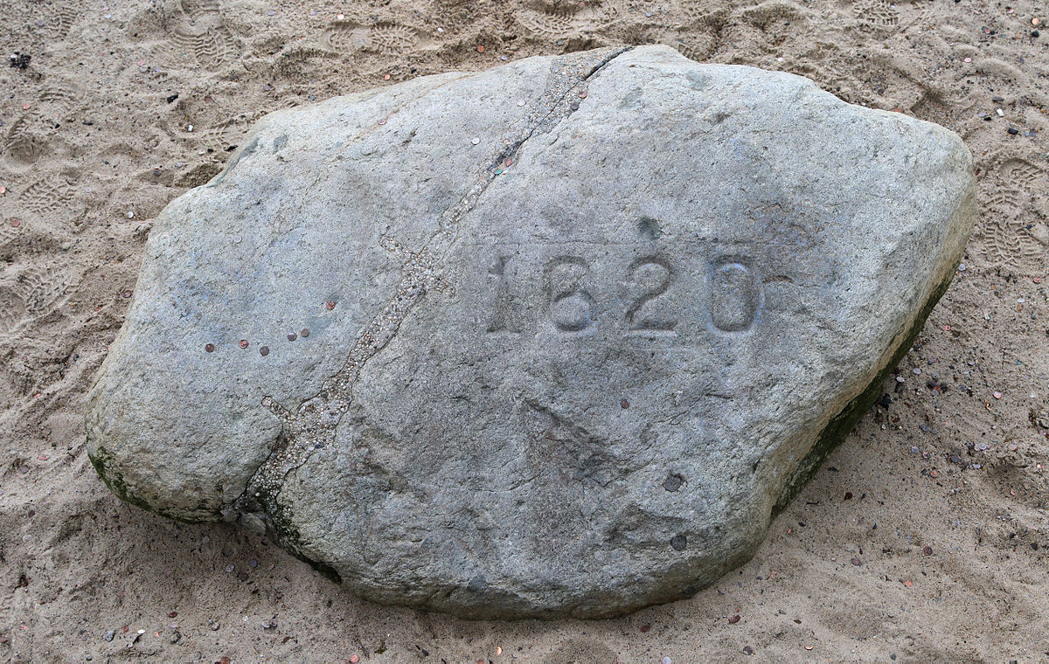

Slide 4
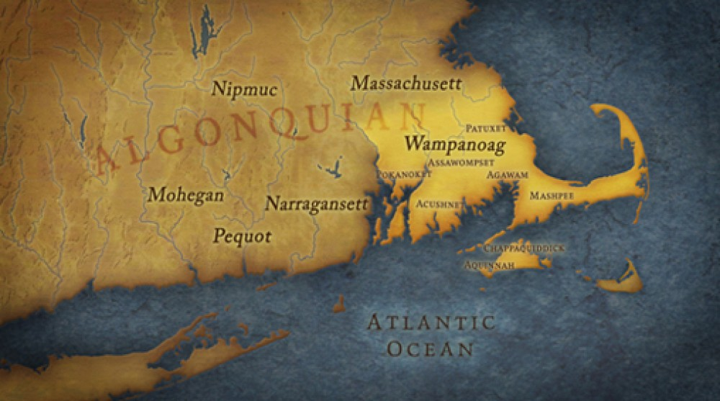

Slide 5
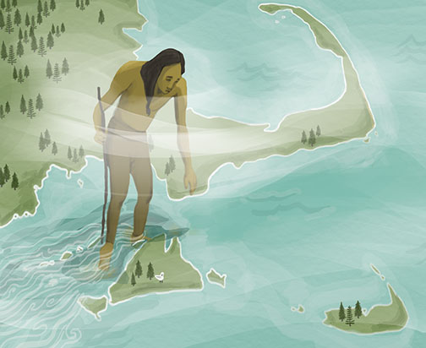
Aquinnah

Slide 7
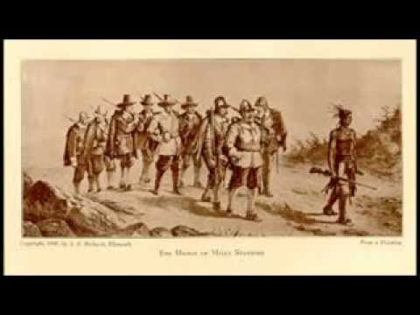
Myles Standish and Men Marching to Wessagussett to Murder Natives There

Slide 8
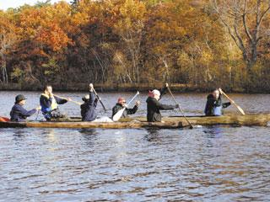

Slide 11
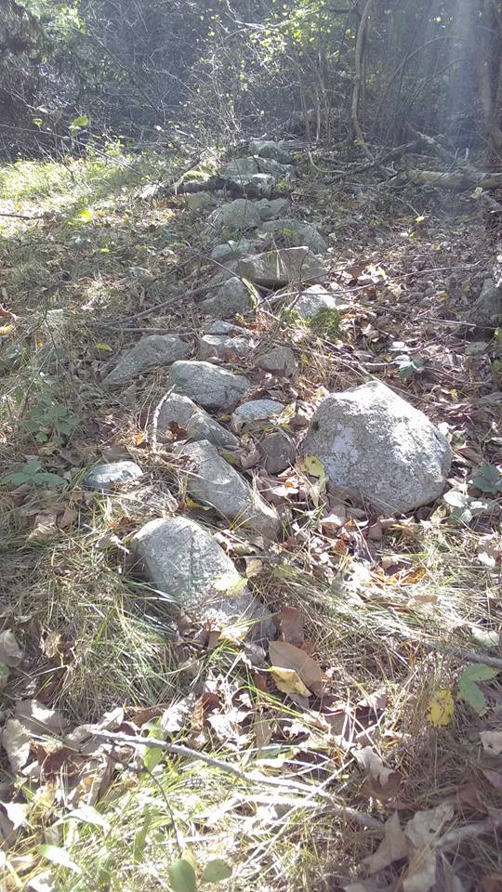
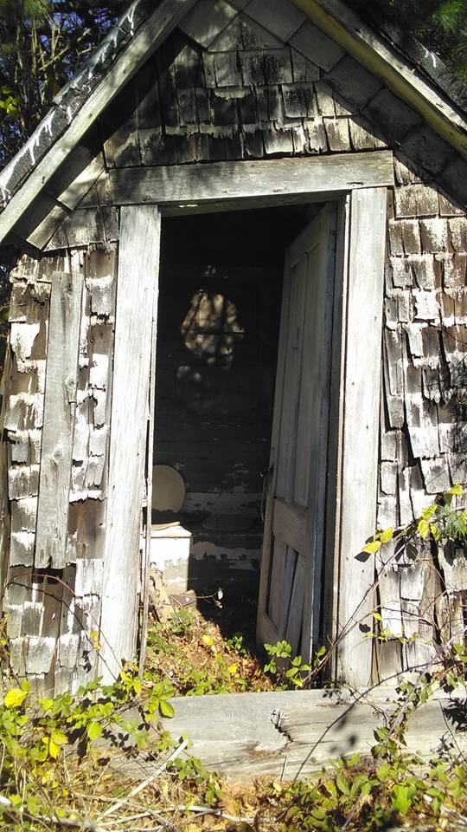

Slide 12
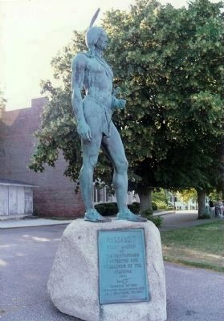
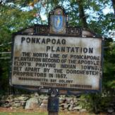
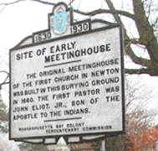
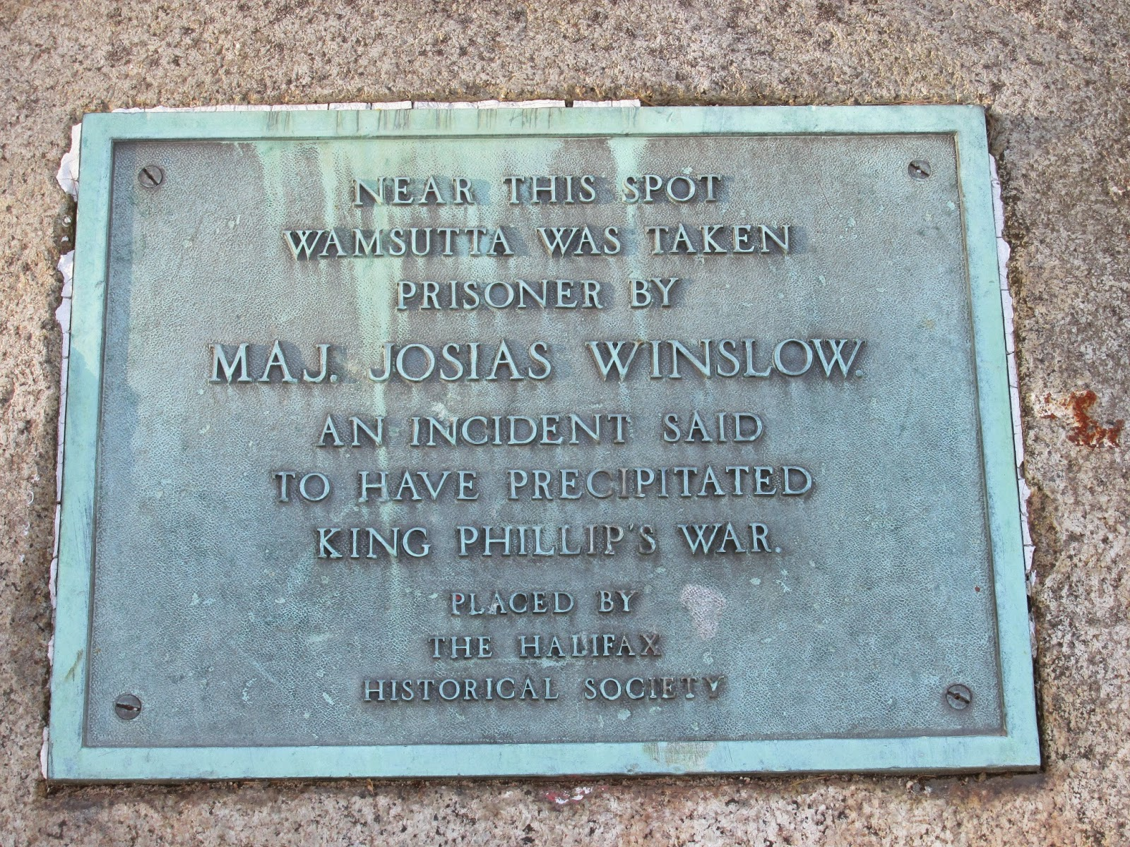
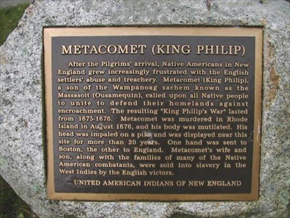

Slide 14
Like every other city or town in Massachusetts and other parts of the US, these signs represent settler colonialism. That means colonists who came to push out the original peoples and stay on their lands. Settler colonial history starts on the incorporated dates.

Slide 16
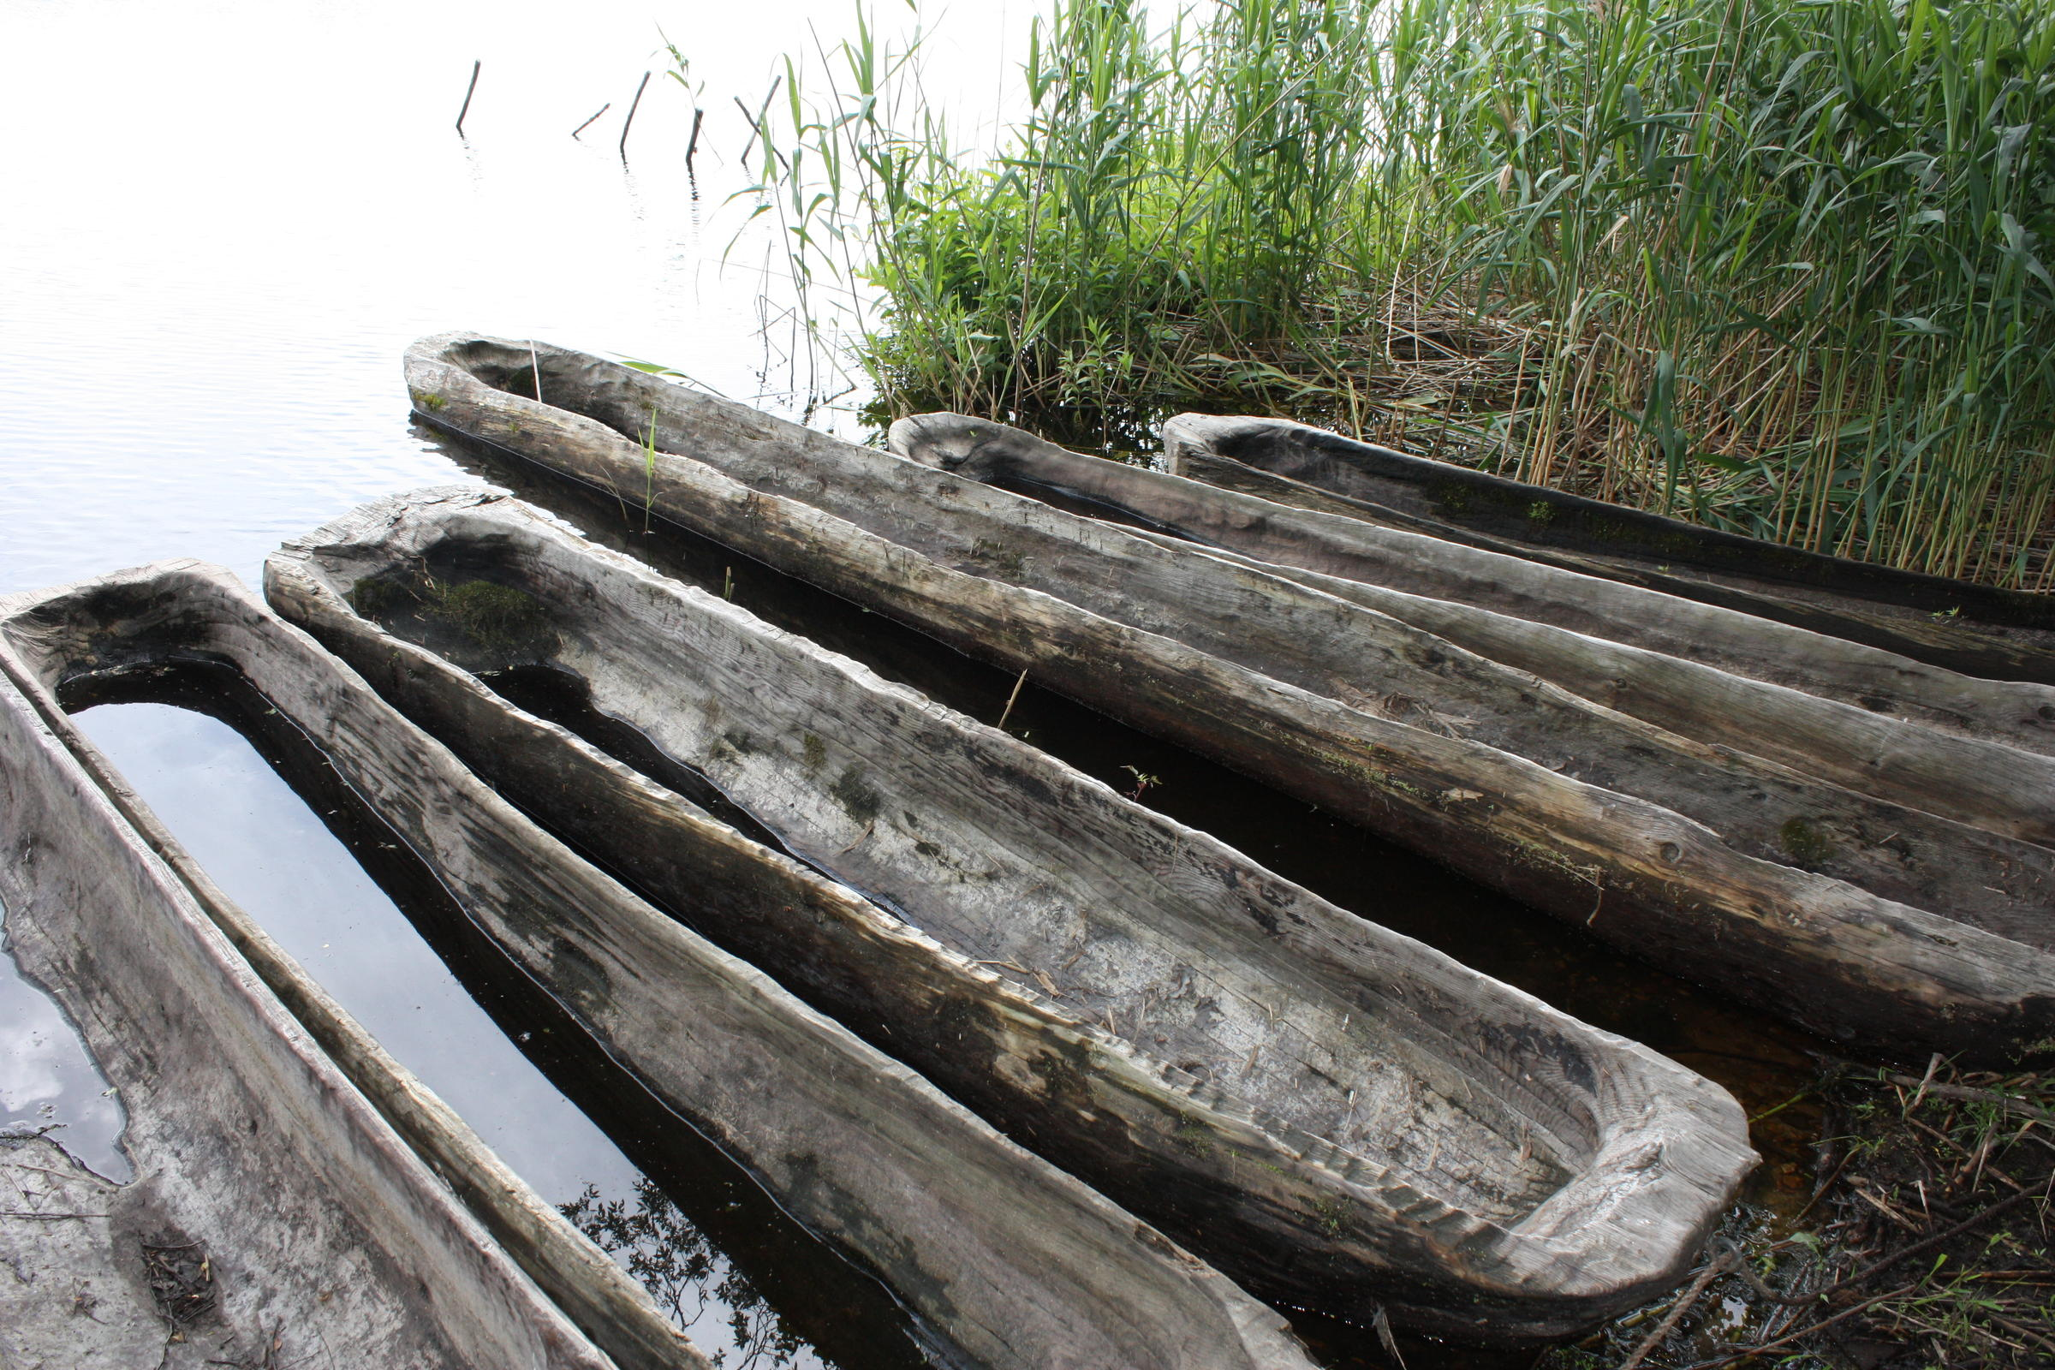
Canoe Passage

Slide 17
Fish Weir in Satucket River East Bridgewater, MA

Slide 18
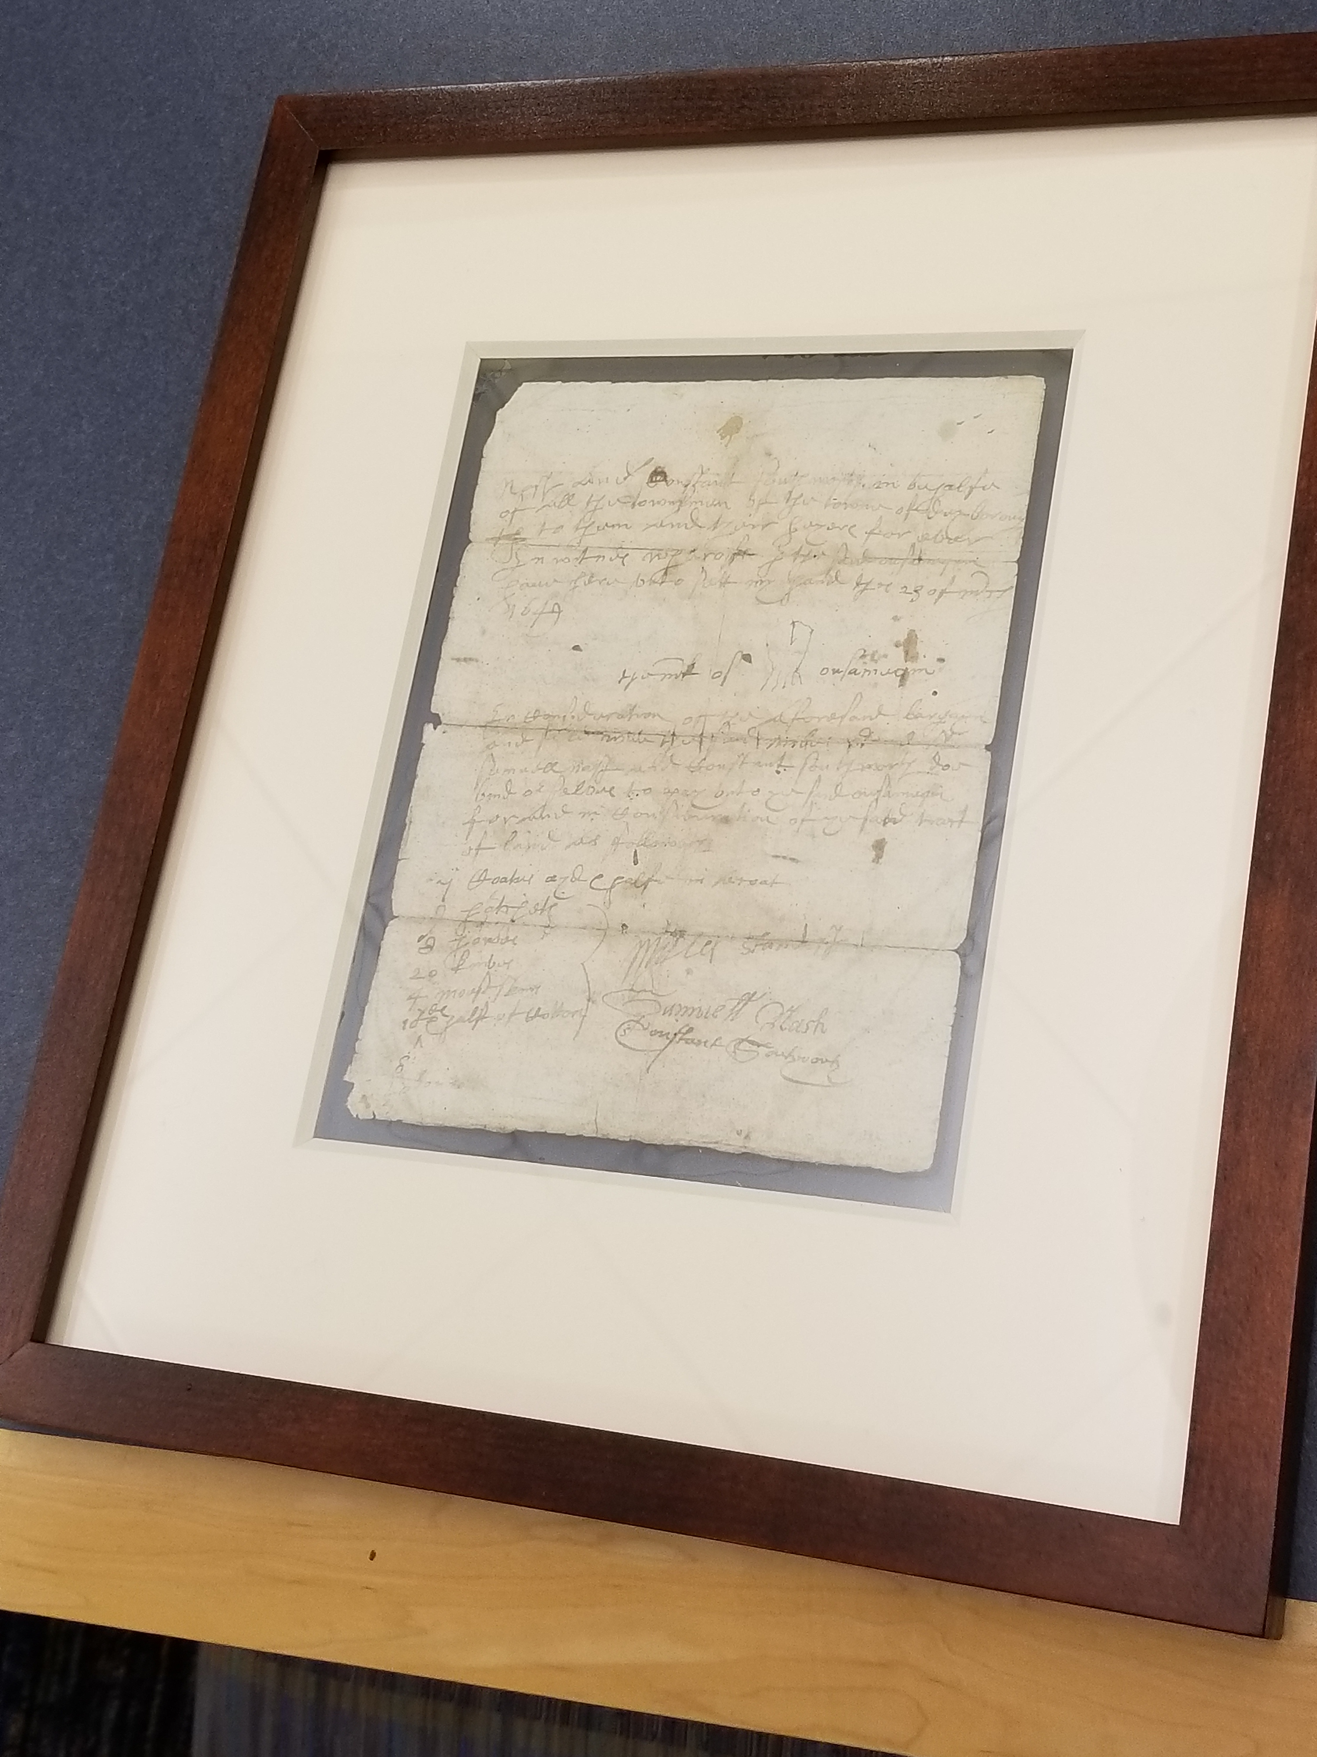
Marker noting the deed signing
Original Deed
Notes:
At the university, we’re working to change that, to tell a story that includes and, dare one say, privileges Indigenous peoples of southeast Massachusetts. The university’s powwow is a community event and the Ethnic and Indigenous Studies Program works to reclaim Native space through speakers, book clubs, and growing a Three Sisters garden each year. All work to strengthen the university’s relationships with local Indigenous peoples, acknowledging we are built upon their lands. By far the most powerful marker of this relationship will be our 2020 Wampanoag history conference to tell the story from a Wampanoag perspective.

Slide 19
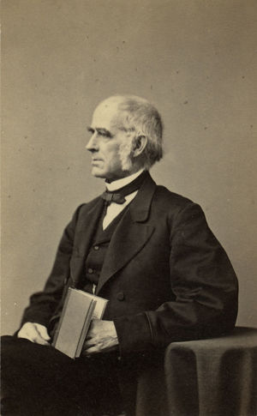
1856

Slide 20
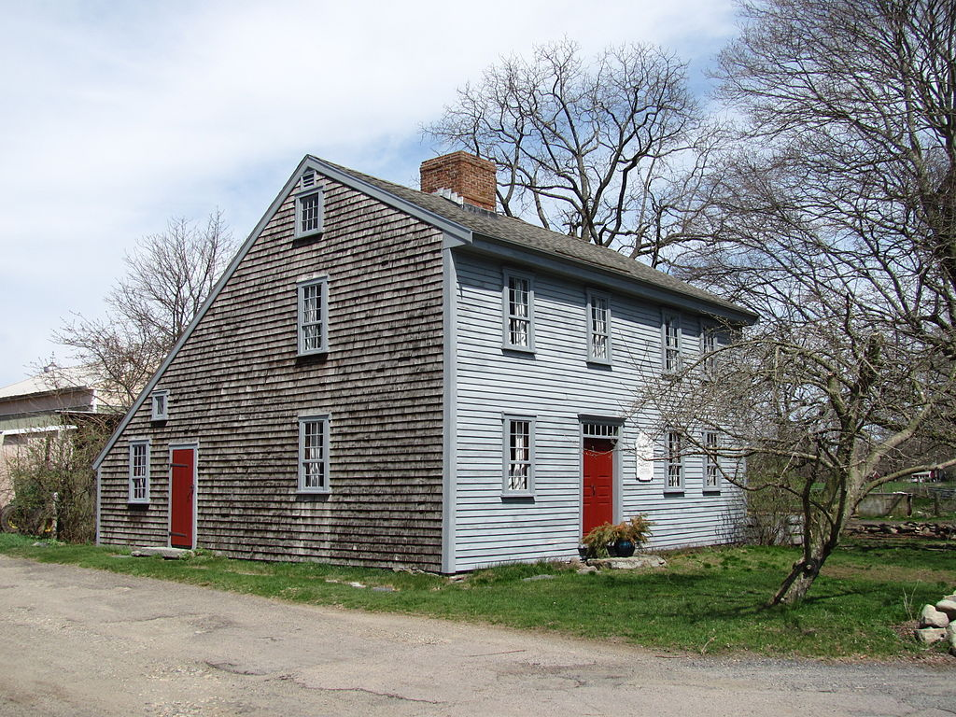
Rev. James Keith House 1662
Notes:
Right around the corner from the Museum Building is the second holding of the OBHS: the home and parsonage of Reverend James Keith, also known as the "Keith House". It is the oldest remaining parsonage building in the United States. It is still located on its original site and has been restored to its 17th century condition. It is located at:
223 River Street
West Bridgewater, MA
The Reverend James Keith Parsonage, sometimes simply called the Keith House, is a 17th-century church parsonage preserved and maintained by the Old Bridgewater Historical Society (OBHS) in West Bridgewater, Massachusetts.^{[2]}According to the OBHS, the Keith House "was built in 1662 by the proprietors of what was originally called the Duxborough Plantation, later called Old Bridgewater, purchased from the Indian Chief Massasoit. The House was built for the first settled minister James Keith, who served the area from 1664 to 1719. Because the area was a colonial outpost, the house also served as a garrison and it was in this house that the wife and son of King Philip were held during the King Philip's War in 1676."^{[1]} The King Philip's War was proportionately one of the bloodiest and costliest in the history of America.^{[3]} More than half of New England's ninety towns were assaulted by Native American warriors.^{[4]} The war is named after the main leader of the Native American side, Metacomet, Metacom, or Pometacom, known to the English as "King Philip."

Slide 21
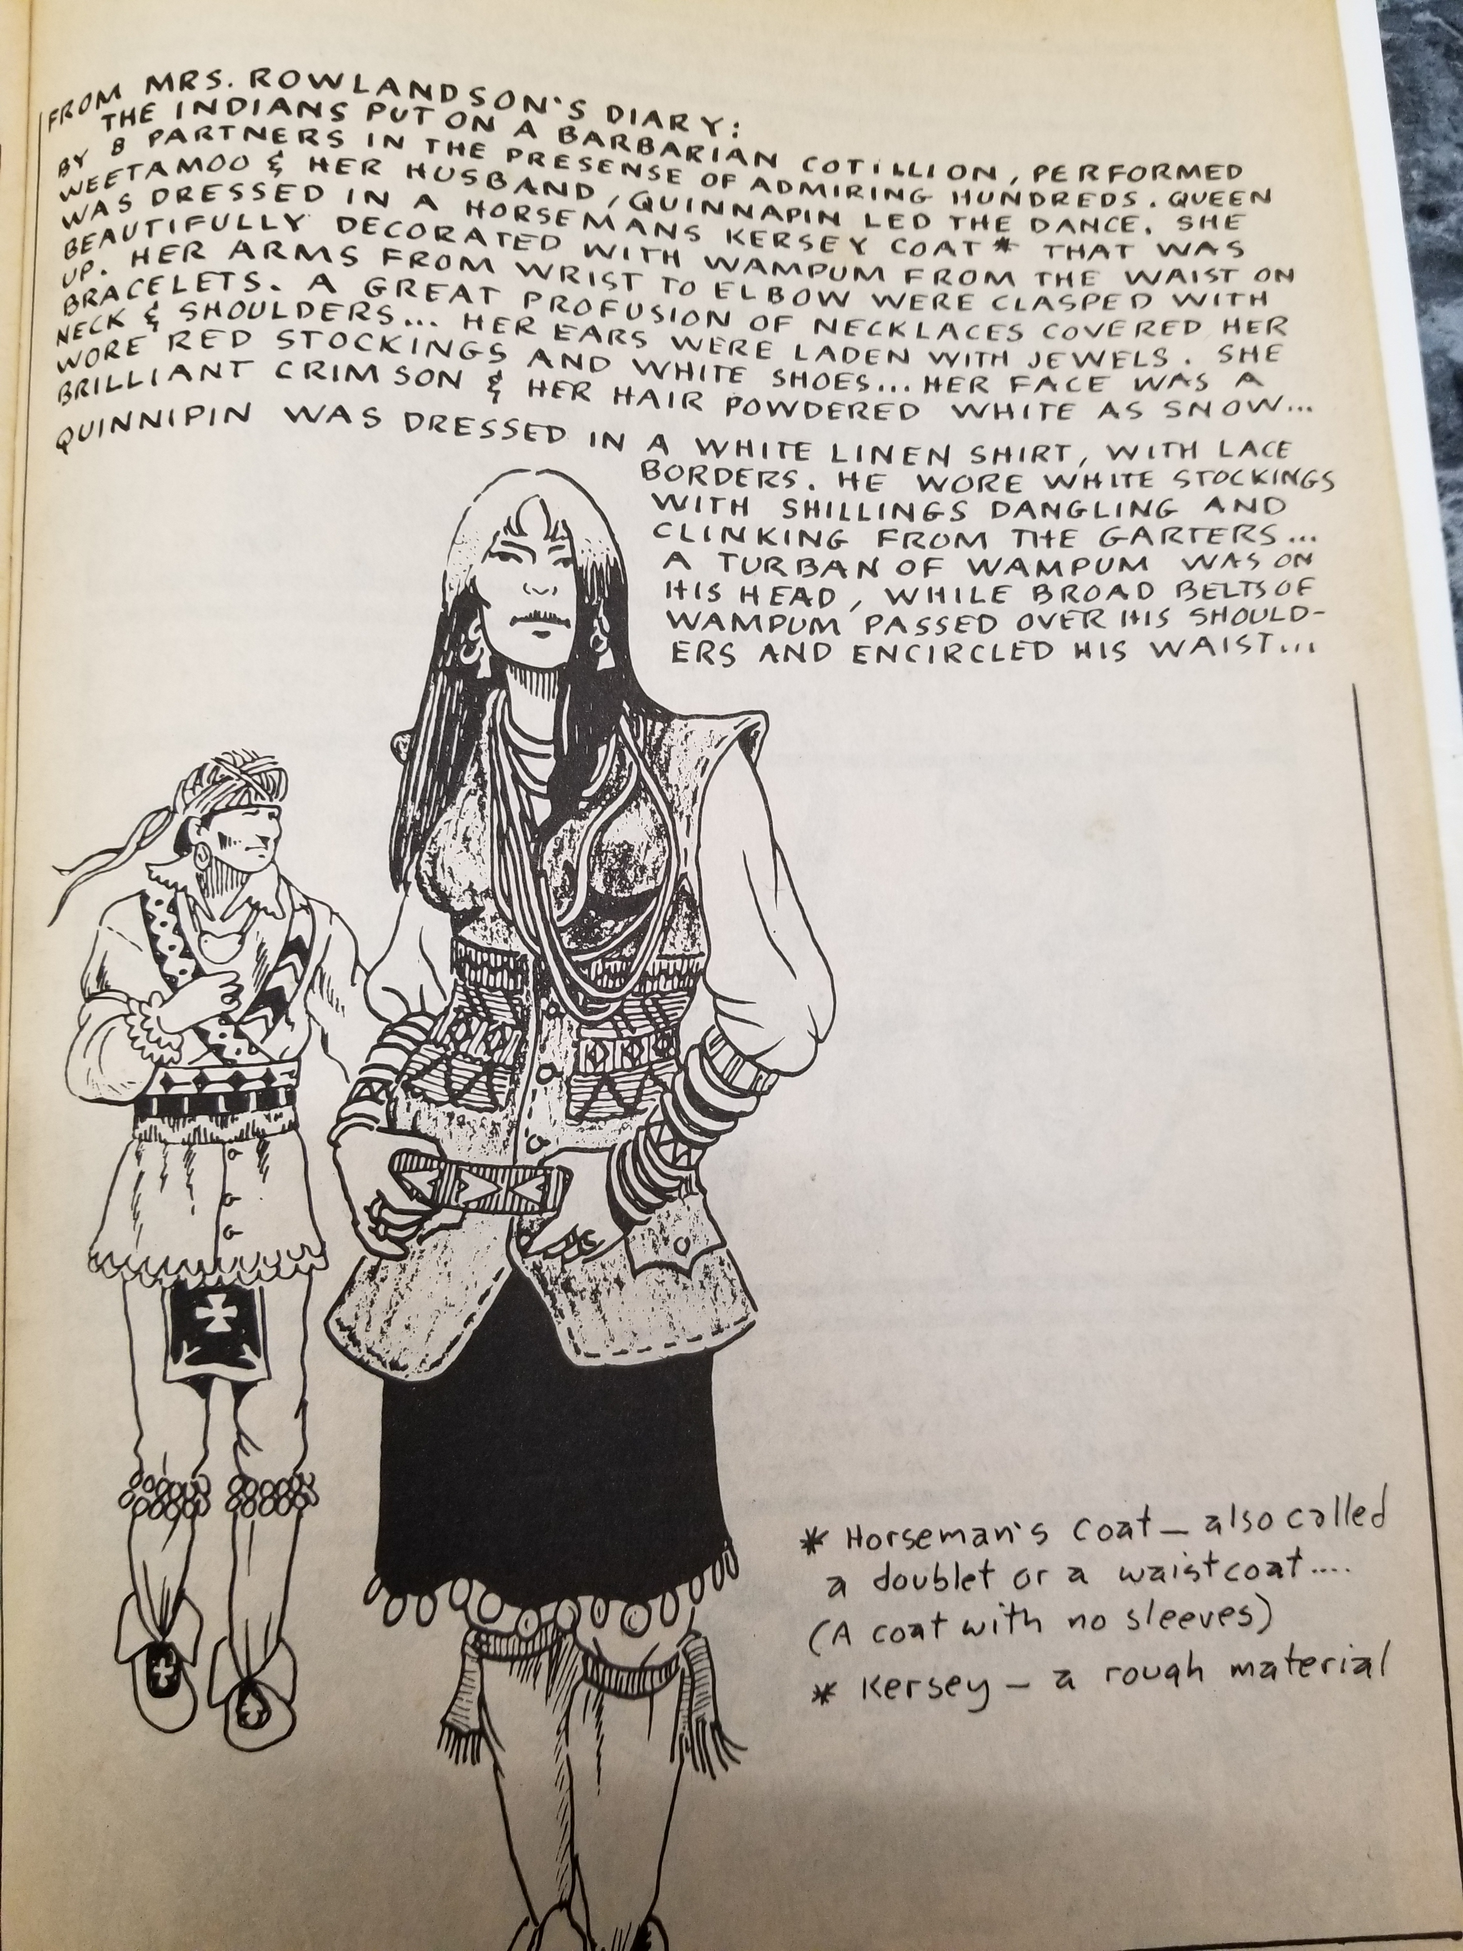
From King Philip’s War a graphic novel

Slide 22
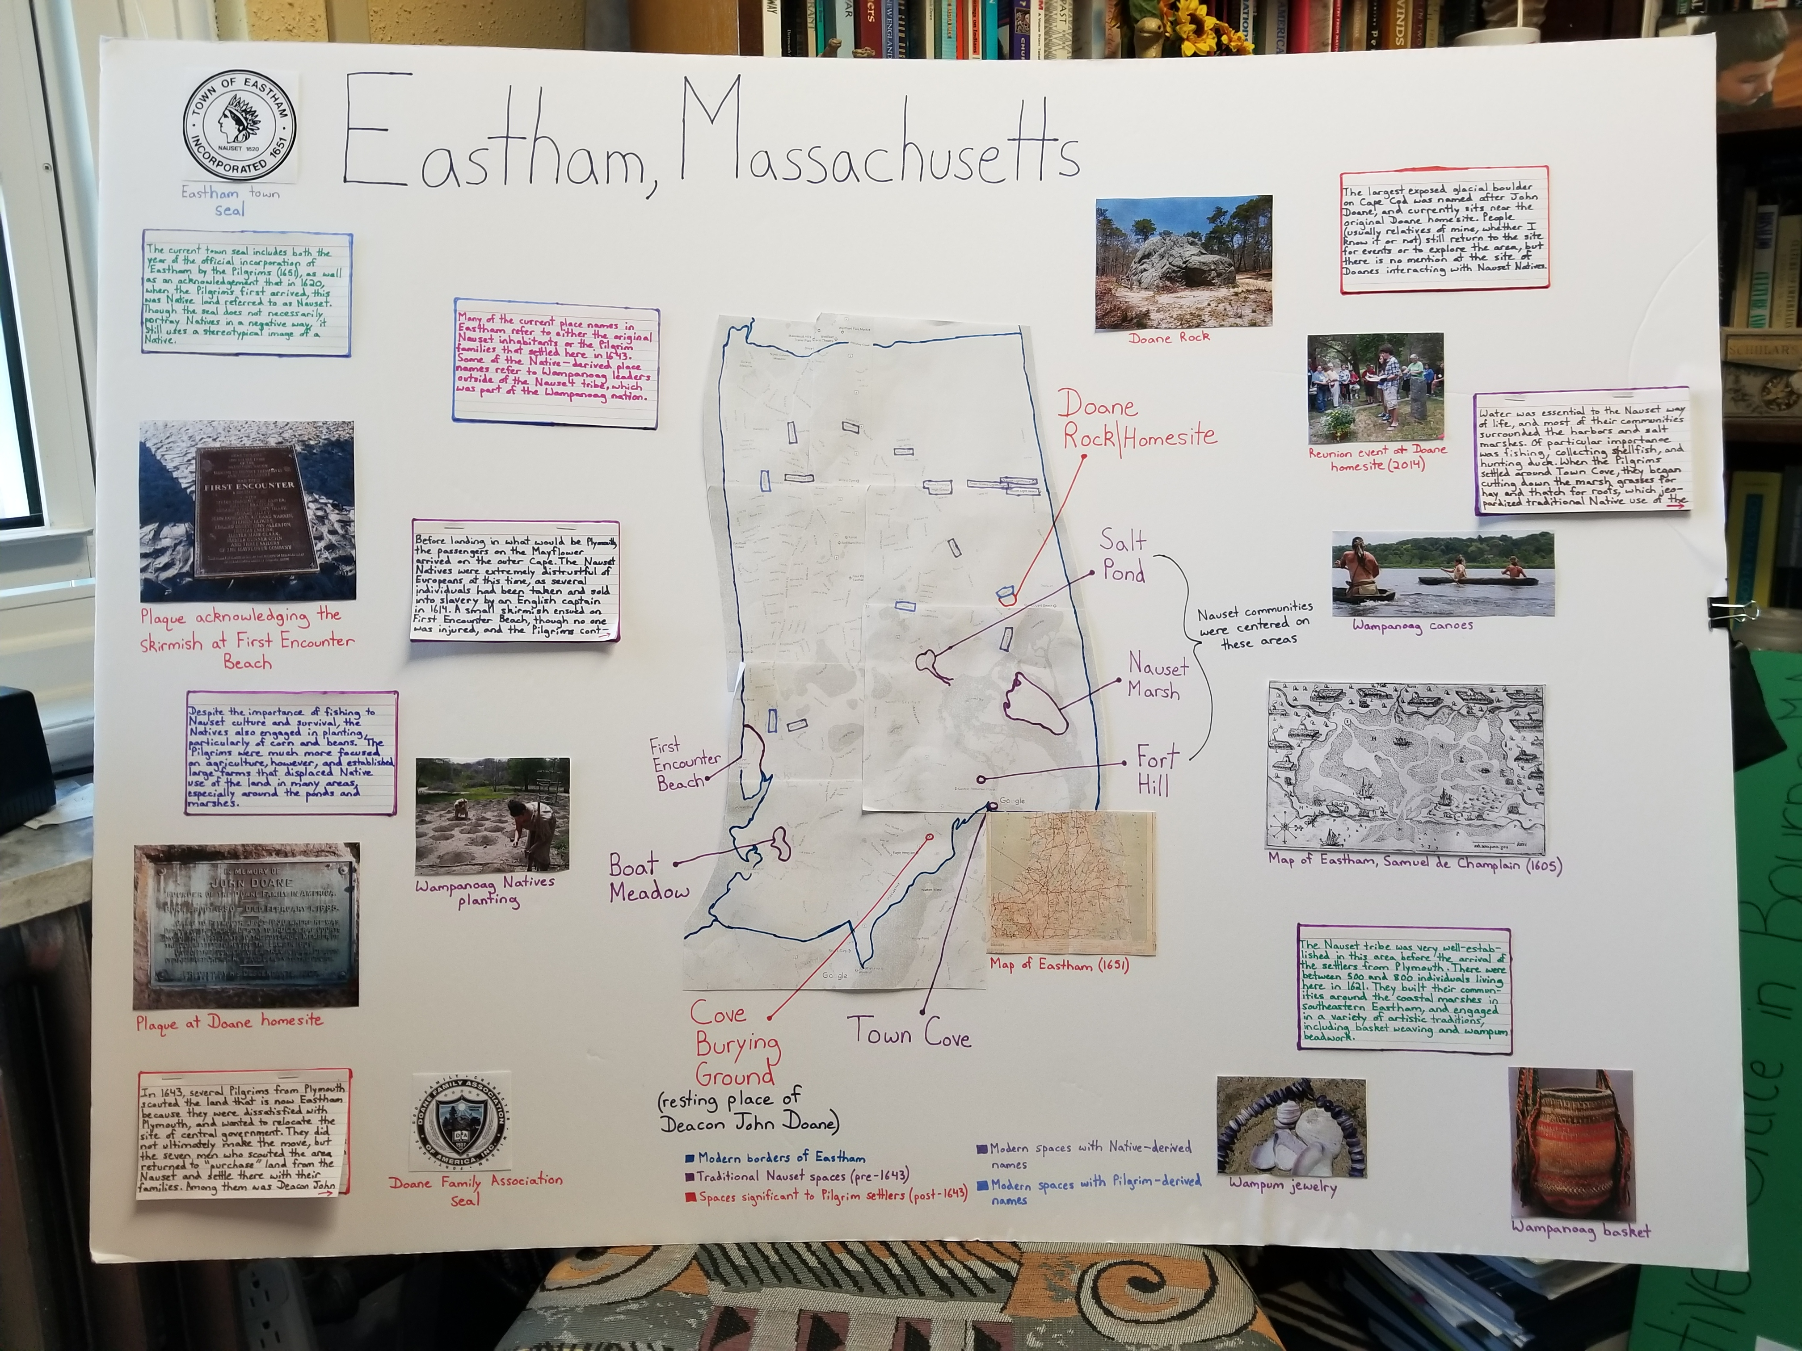
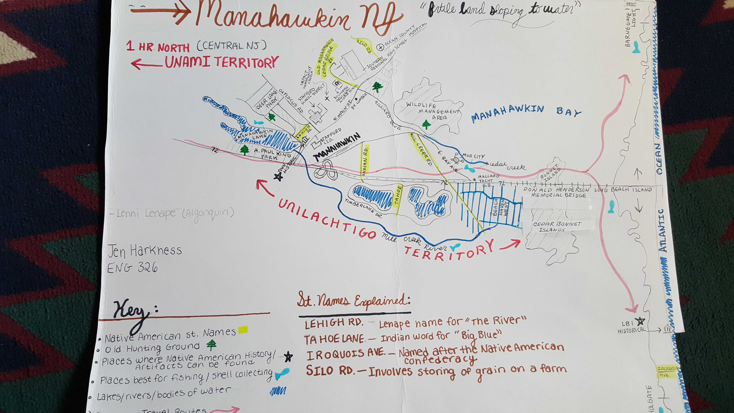
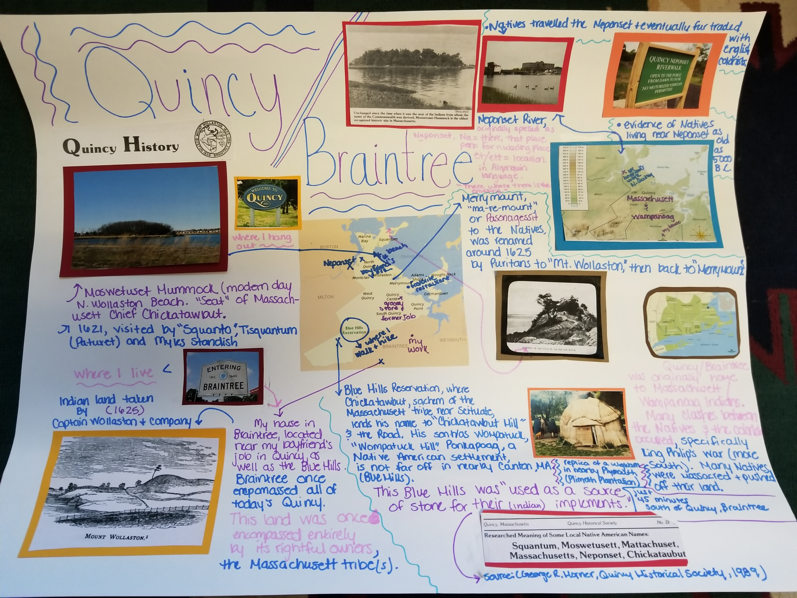

Slide 23
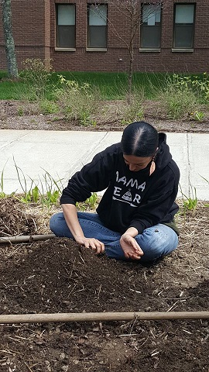
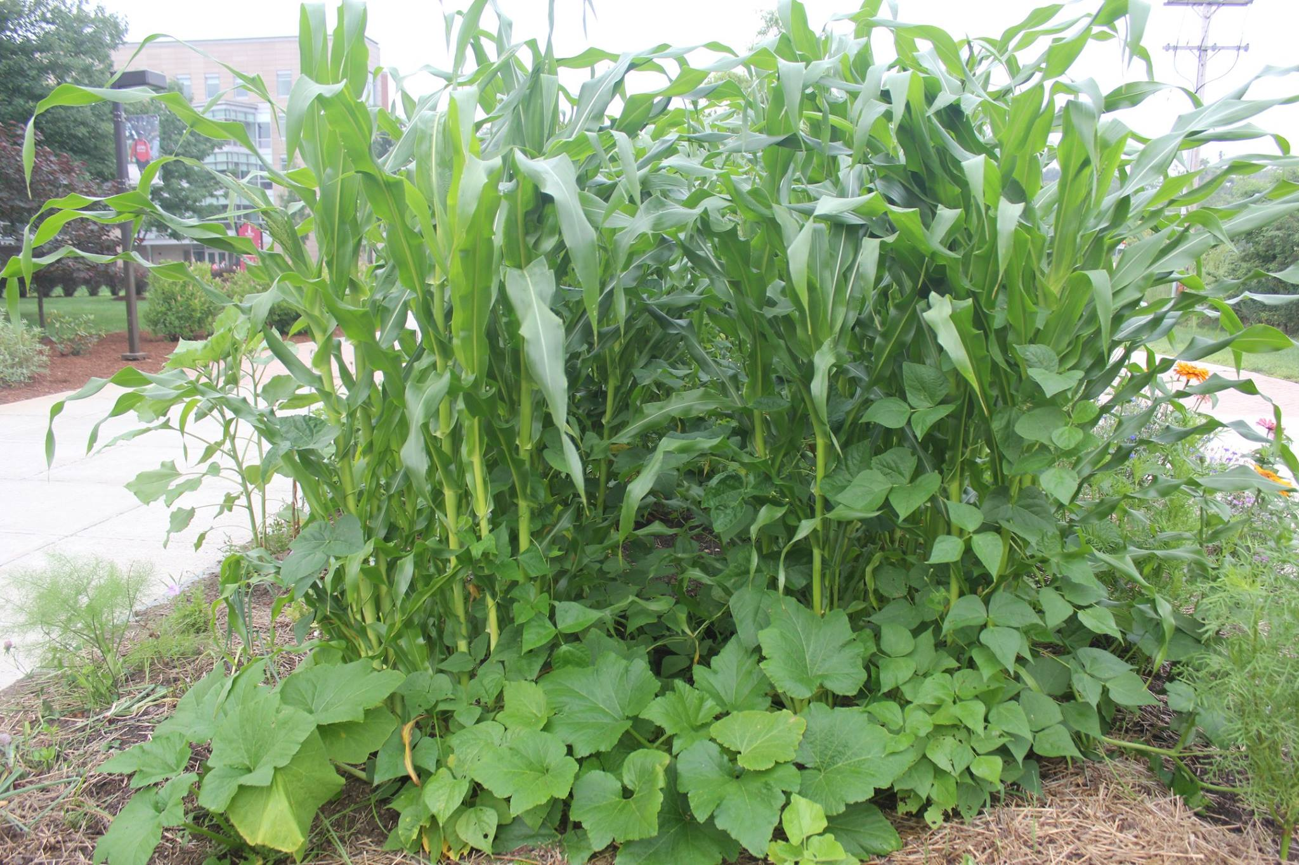

Slide 24
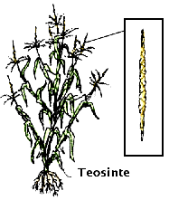
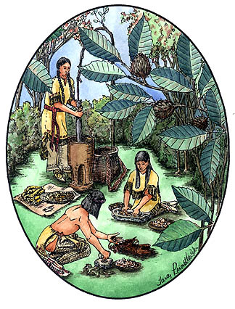
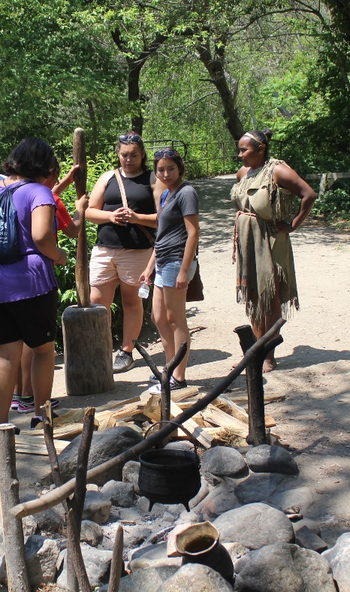

Slide 25
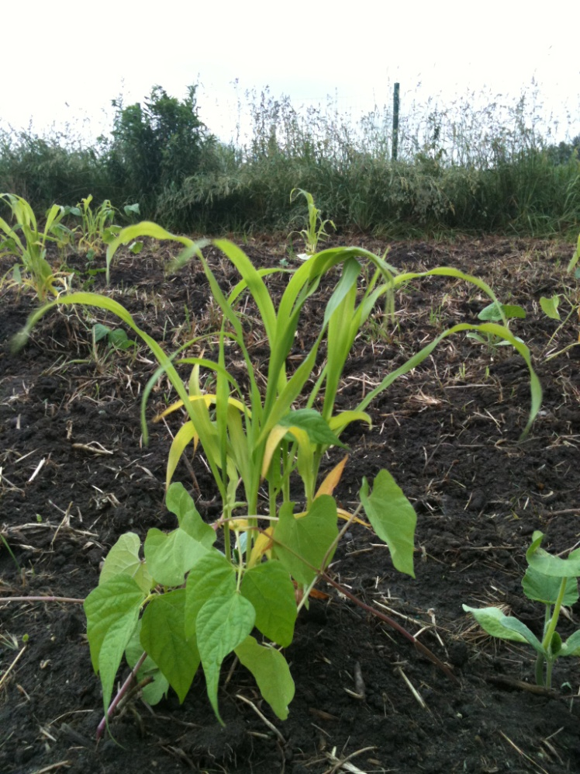
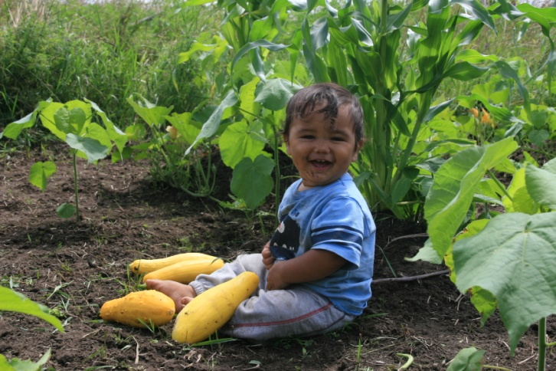
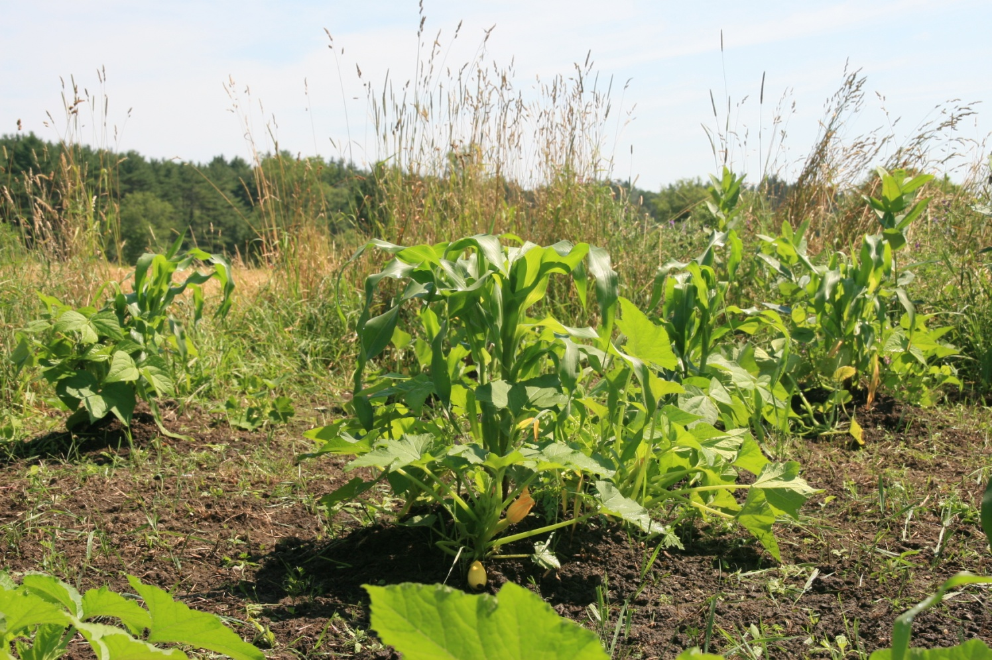

Slide 27
